Slide 1
Basics of Chemistry
Biology 9/22/14

Slide 2
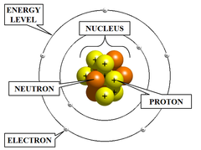
All Things are made of Atoms
Part | Location | Electric Charge | Mass
Proton | Nucleus | Positive | 1 mass unit
Neutron | Nucleus | None | 1 mass unit
Electron | Orbiting in various energy levels | Negative | Nearly zero
Parts of an atom:
The number of protons determines which element the atom is. When electrons vary it is an ion. When neutrons vary it is an isotope.

Slide 3
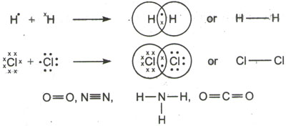
Atoms Bond together to form larger molecules
1. Covalent bonds= when atoms share electrons
Depending on how many electrons are shared, can be either:
Single
Double
or Triple

Slide 4
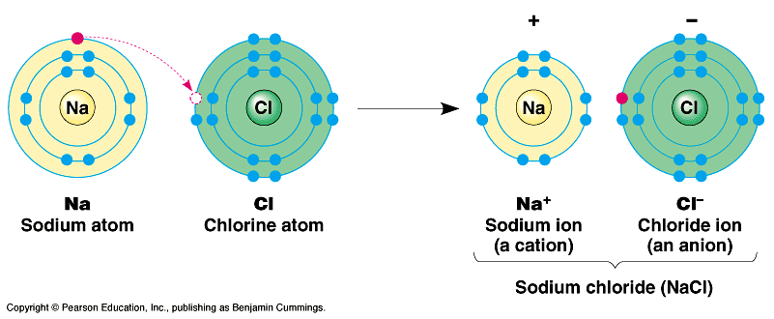
2. Ionic Bonds= when an electron from one atom is transferred to another atom. This leaves one positively charged ion and one negatively charged ion that are bonded to each other (opposites attract)
Ionic molecules dissociate in water. Meaning the ions separate from one another and form a solution with the water. This solution will conduct electricity.

Slide 5
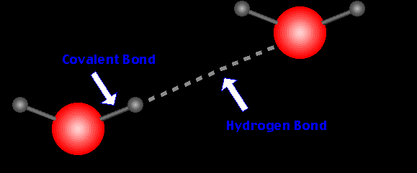
3. Hydrogen Bonds= When two molecules that have weak partial positive and weak partial negative parts (polar molecules) are attracted in a relatively weak interaction (think magnets)
TECHNICALLY NOT A BOND. Merely an “attraction”

Slide 6
Bond Strength:
Bond Type | Bond Strength | Bond strength is determined by how much energy (heat) it takes to break the molecule apart
Covalent | Strongest (double and triple bonds are even stronger)
Ionic | Strong
Hydrogen Bonds | Weakest

Slide 7
Properties of Water
Biology 9/26/14

Slide 8
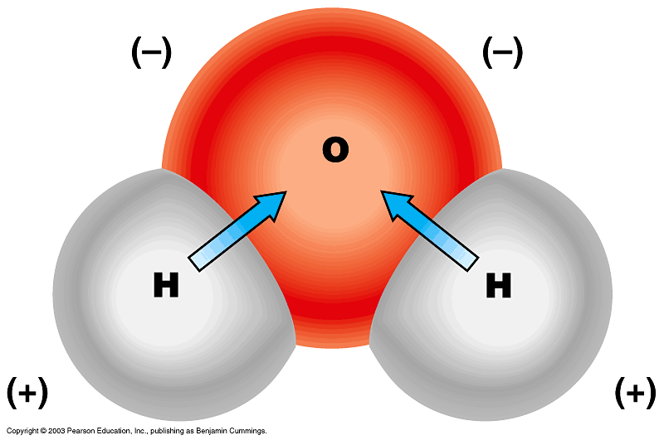
Properties of Water
Water is POLAR!!
POLAR covalent bond = unequal sharing of electrons
Creates slightly positively charged and negatively charged sides of the molecule (like a magnet)
Oxygen is an “electron hog” so the oxygen is more (-) and hydrogens more (+)

Slide 9
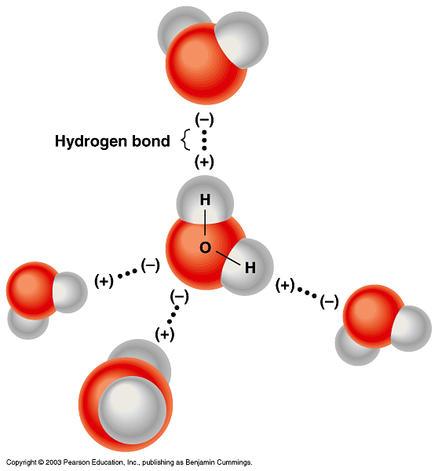
Hydrogen Bond- attraction between water molecules
Polarity and Hydrogen bonds give H₂O some unique and very important properties! :

Slide 10
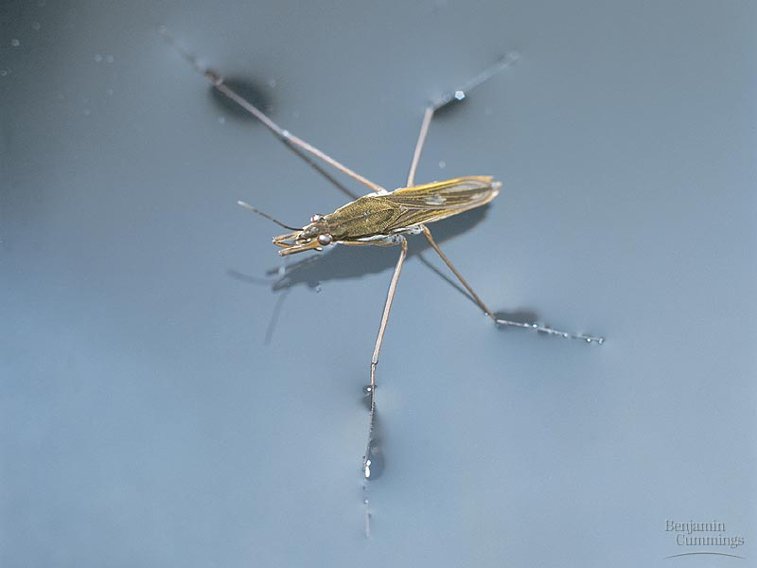
1. Cohesion, Adhesion and Surface Tension
cohesion = H₂O attracted to other H₂O molecules
adhesion = H₂O attracted to other materials
surface tension = molecules at the surface are attracted to each other even more strongly because no like molecules on one side
These are all created because of the hydrogen bonding between molecules!

Slide 11
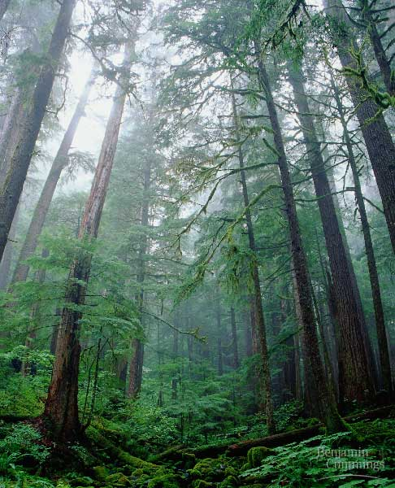
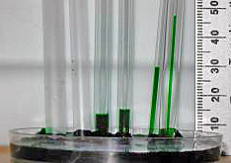
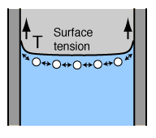
2. Capillary Action
Because water has both adhesive and cohesive properties, it will “climb” up a narrow tube.
Ex: Think water in a straw
Ex: Water moves through trees this way

Slide 12
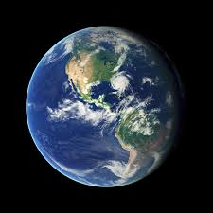
3. High Heat Capacity
It takes much more energy to heat H₂O than most other liquids. Water also holds heat longer!
Water’s ability to “store” heat is HUGELY important for our climate!!!

Slide 13
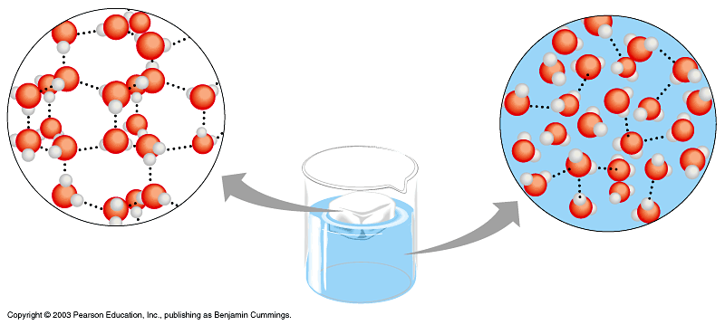
4.Density
Water is LESS dense as a solid! Because the hydrogen bonds are stable in ice – each molecule of water is bound to four neighbors therefore spaced farther apart.
This is also HUGELY IMPORTANT! If ice was at the bottom a lake would continue to freeze until solid. (Poor fishies ☹)

Slide 14
ACIDS and Bases
Biology 10/2/14

Slide 15
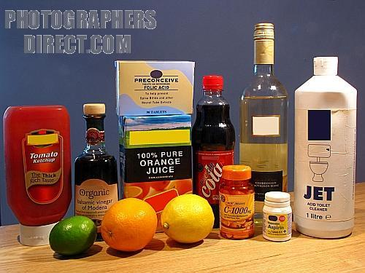
Acids
Give up a Hydrogen ion (H⁺) when in water
Taste sour
Strong acids can burn skin & eyes
Strong acids can dissolve metals
Examples:
Lemon juice
Vinegar
Car battery acid

Slide 16
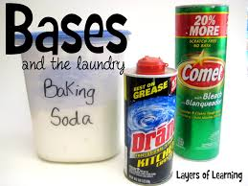
Bases
Produce a Hydroxide ion (OH⁻) when put in water
Can taste bitter
Strong bases can burn skin & eyes
Bases react more easily with protein than with metal; they are often used for cleaning
Examples:
Milk
Baking soda
Soap
Drain cleaner (dangerous!)

Slide 17
Chemicals that produce neither (H⁺) nor (OH⁻) ions are said to be neutral.
Water is neutral because it would split into both ions equally.
pH scale measures how acidic or basic a solution is.
0--------------7---------------14
Acid Neutral Base

Slide 18
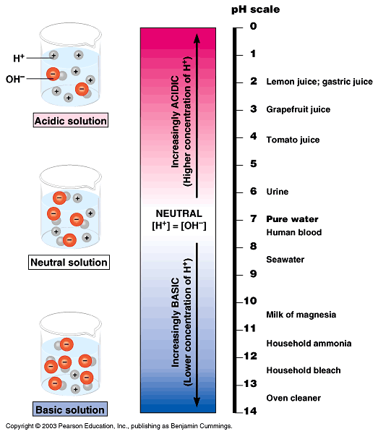
The pH Scale
“p” stands for potential and “H” stands for Hydrogen
-the potential of a substance to produce Hydrogen ions
pH scale ranges from 0 -14
pH 7 is neutral; neither acid nor base
Low pH (0-6.9) = acid
High pH (7.1-14) = base
The closer to the ends of the scale, the stronger the solution is

Slide 19
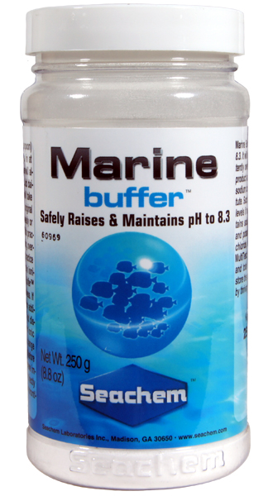
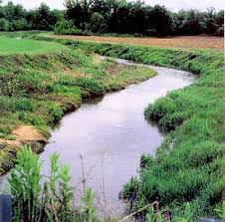
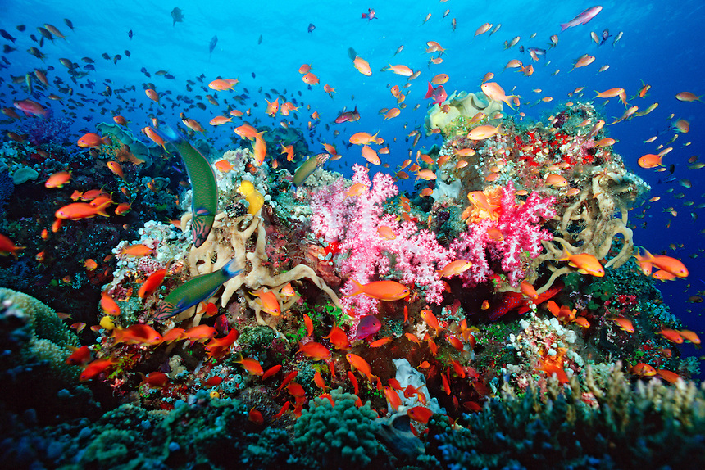
BUFFERS -
Keep pH steady within a small range.
Natural buffers are VERY important in Biology! (think about soil, lakes and streams, and oceans)
NEUTRALIZATION -
Acid + Base= Water + a salt
Example: HCl + NaOH = H₂O + NaCl

