Slide 1
characteristics of Life
Must have ALL characteristics to be alive!!!

Slide 2
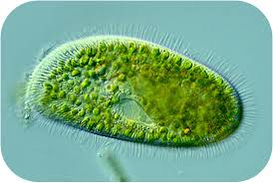
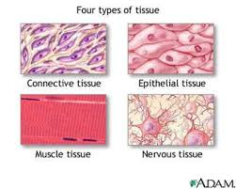
1. Organized
(Into one or more cells)

Slide 3
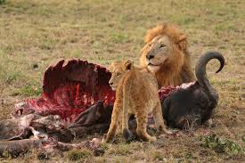
2. Requires Energy
(in order to perform life’s processes)

Slide 4
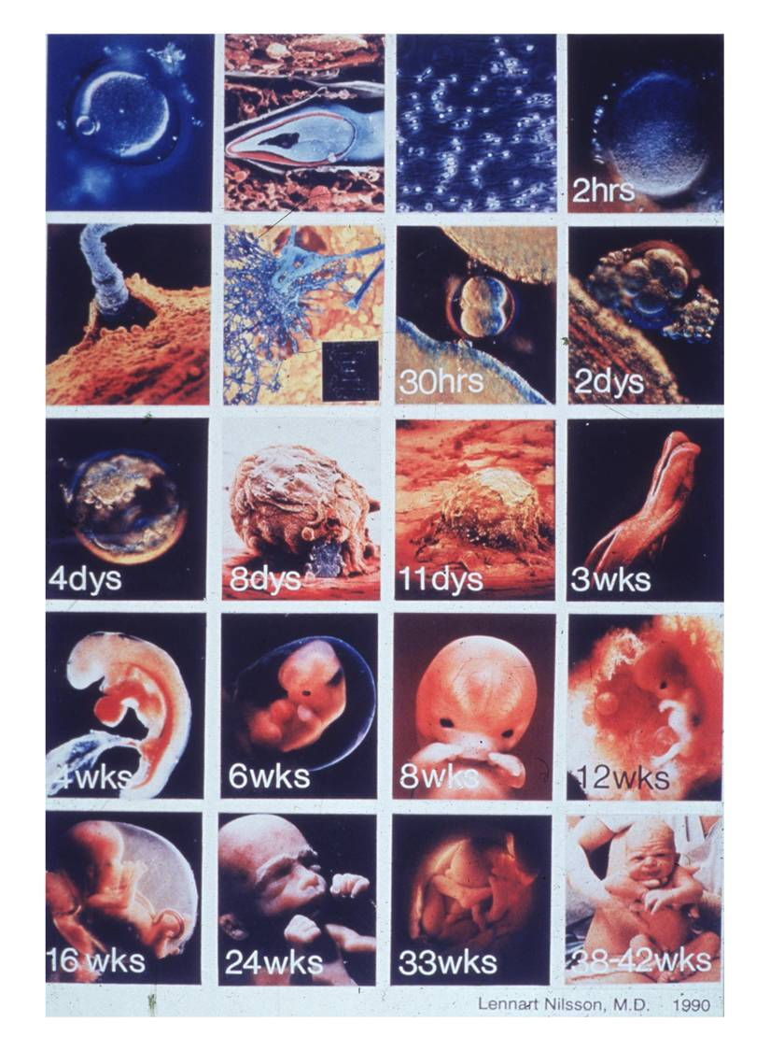
3. Growth 4. Development
(Growth= increase in size)
(Development= change in structure or shape)

Slide 5
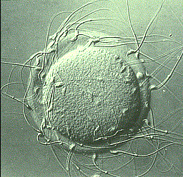
5. reproduction
(Sexual= 2 individuals create genetically unique offspring)
(Asexual= 1 individual creates a genetically identical clone)

Slide 6
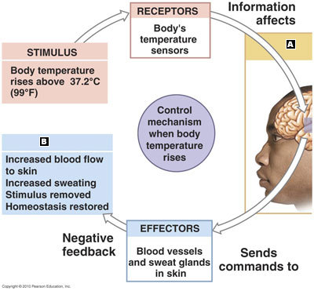
6. Responds to environmental “stimuli”
(to maintain homeostasis)

Slide 7
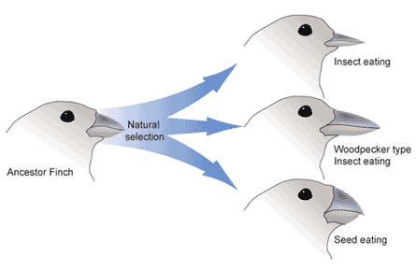
7. Adaptation
(change of species over long period of time)

Slide 8
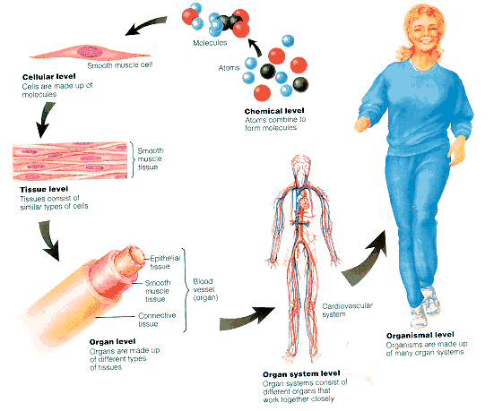
What are the levels of organization in an organism?
-chemical (subatomic, atomic,
molecules, macromolecules)
-organelles
-cells (differentiated to perform unique functions) 100 Trillion!
-tissues
-organs
-organ system (see below)
-organism (human)

