Slide 1
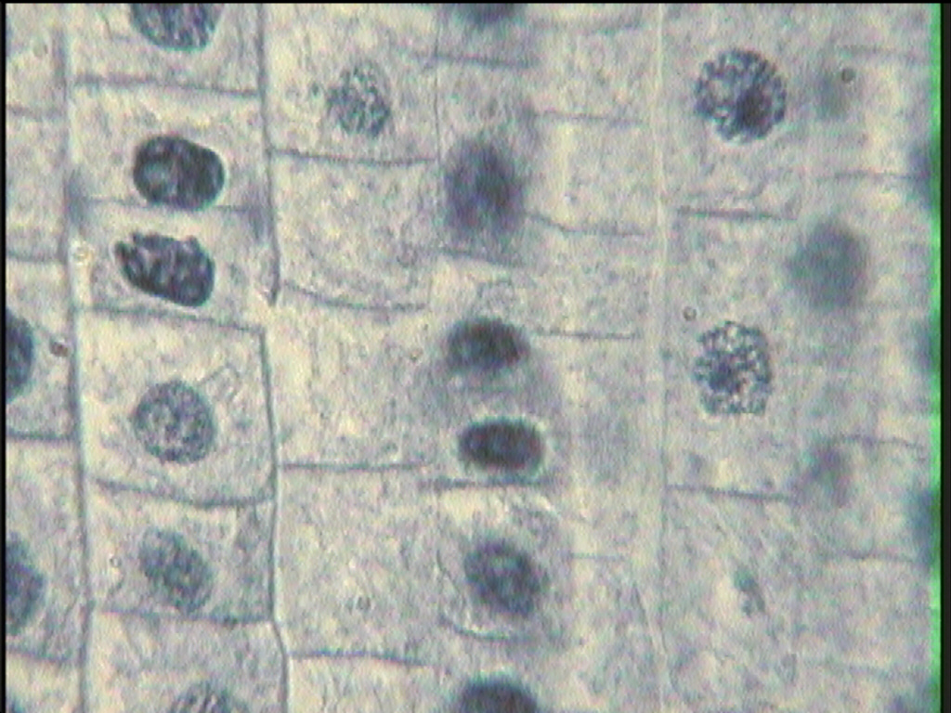
Cell Cycle and
Mitosis
(Cell Division)
(Asexual Reproduction)
1

Slide 2
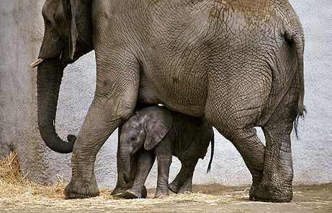
How do little elephants grow up to be BIG elephants?

Slide 3
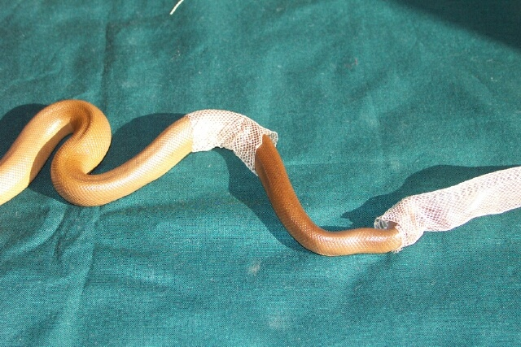
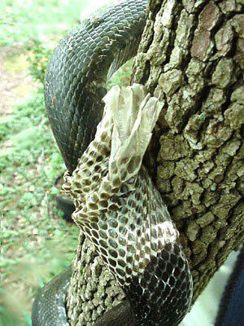
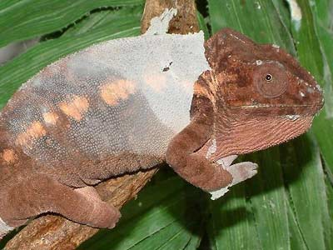
Why do animals shed their skin?

Slide 4
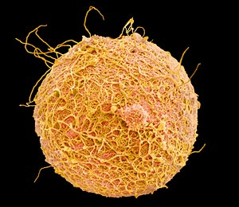
The process of asexual reproduction begins after a sperm fertilizes an egg.

Slide 5
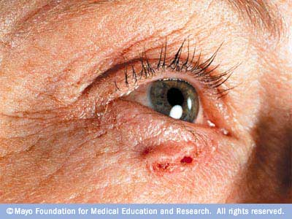
Three reasons why cells reproduce by asexual reproduction: 1. Growth 2. Repair 3. Replacement
Skin cancer - the abnormal growth of skin cells - most often develops on skin exposed to the sun.
Cell that reproduce by asexual reproduction reproduce constantly.

Slide 6
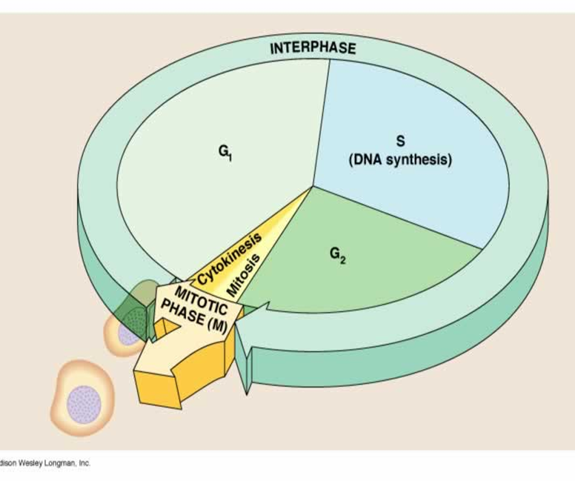
Cell Cycle
INTERPHASE
Cell is either at rest or preparing to divide
3 parts
MITOSIS and Cytokinesis
Cell is actively dividing
4 parts

Slide 7
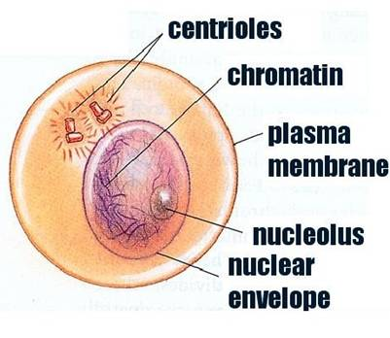
Interphase occurs before mitosis begins
Chromosomes are copied (# doubles)
Chromosomes appear threadlike (chromatin)
but each chromosome and its copy(sister chromosome) are attached “sister chromatids” at end of this phase

Slide 8
Interphase
Animal Cell
Plant Cell
Photographs from: http://www.bioweb.uncc.edu/biol1110/Stages.htm

Slide 9
Interphase
The 3 parts of interphase are:
Gap 1 (G1)
-cell grows larger
Synthesis (S)
-all DNA is copied
Gap 2 (G2)
-cell grows larger
-new organelles produced

Slide 10
Interphase
There are also checks for errors in the DNA copying.
Errors may cause the cell to self destruct
Apoptosis= programmed cell death

Slide 11
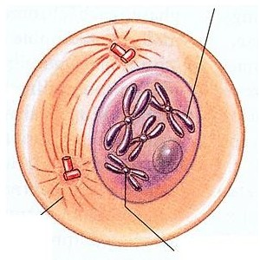
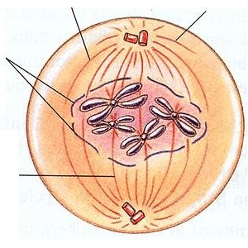
Prophase 1st step in Mitosis
Chromatin condenses into Chromosomes (sister chromatids)
Centrioles appear and begin to move to opposite ends of the cell (poles)
Spindle fibers form between the poles.
Nuclear membranebreaks down.

Slide 12
Prophase
Animal Cell
Plant Cell
Spindle fibers
Centrioles
Photographs from: http://www.bioweb.uncc.edu/biol1110/Stages.htm

Slide 13
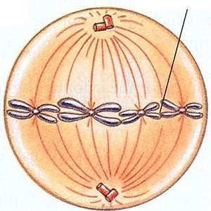
Metaphase 2nd step in Mitosis
Chromatids (or pairs of chromosomes) attach to the spindle fibers.
- Chromatids Line up at Middle of cell

Slide 14
Metaphase
Animal Cell
Plant Cell
Photographs from: http://www.bioweb.uncc.edu/biol1110/Stages.htm

Slide 15
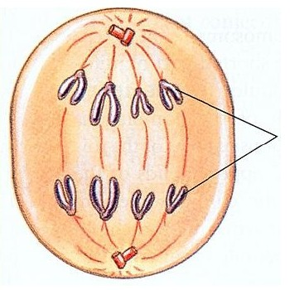
Anaphase 3rd step in Mitosis
Chromatids (or pairs of chromosomes) pulled Apart to opposite sides.

Slide 16
Anaphase
Animal Cell
Plant Cell
Photographs from: http://www.bioweb.uncc.edu/biol1110/Stages.htm

Slide 17
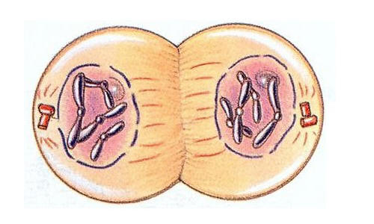
Telophase 4th step in Mitosis
Two new nuclei form.
Chromosomes appear as chromatin (threads rather than rods).
Nuclear membranes reappear
Mitosis ends.

Slide 18
Telophase
Animal Cell
Plant Cell
Photographs from: http://www.bioweb.uncc.edu/biol1110/Stages.htm

Slide 19
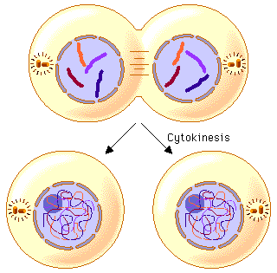
Cytokinesis occurs after mitosis!
Cell membrane moves inward to create two daughter cells – each with its own nucleus with identical chromosomes.

Slide 20
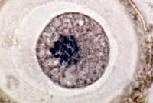
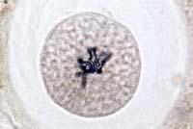
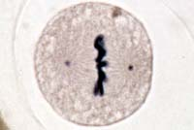
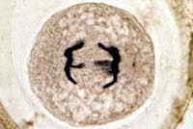
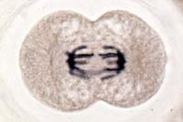
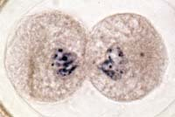
Animal Mitosis -- Review
Interphase | Prophase
Metaphase | Anaphase
Telophase | Interphase

Slide 21
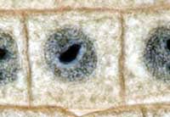
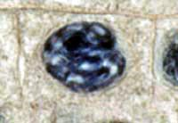
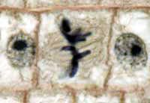
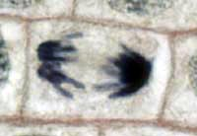
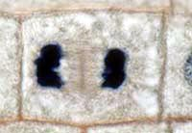
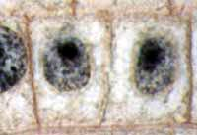
Plant Mitosis -- Review
Interphase | Prophase
Metaphase | Anaphase
Telophase | Interphase

Slide 22
REMEMBER!
Interphase
Prophase
Metaphase
Anaphase
Telophase
Cytokinesis
IPMATC
I Played My Accordian This Christmas
Notes:
A mnemonic to help remember the stages of mitosis.

Slide 23
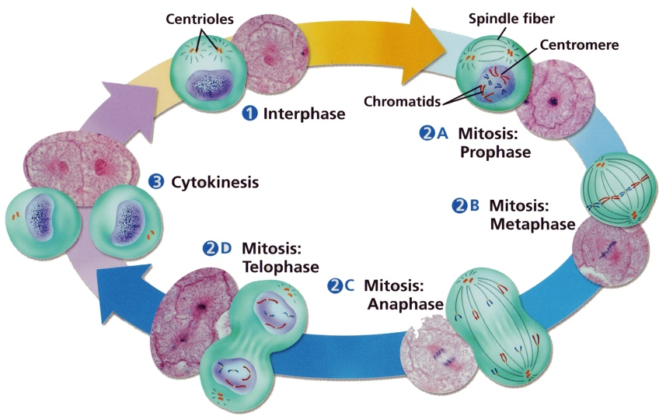
Cell Cycle

Slide 24
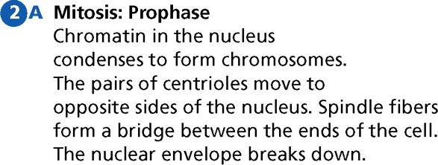
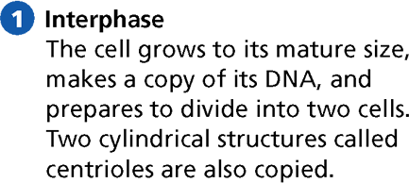
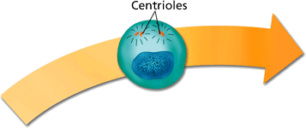
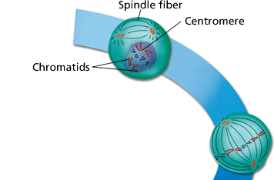
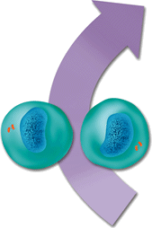
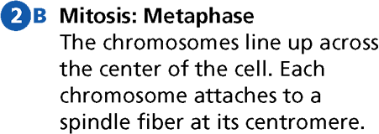
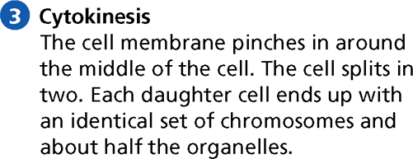
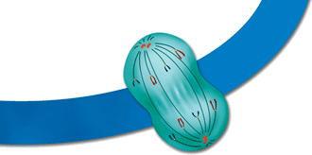
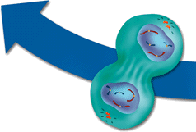
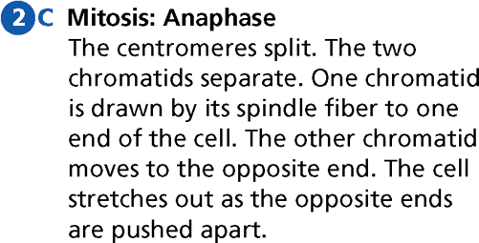
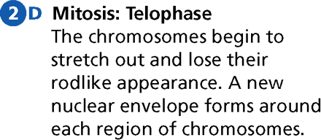
The Cell Cycle
- Cell Division
24

Slide 25
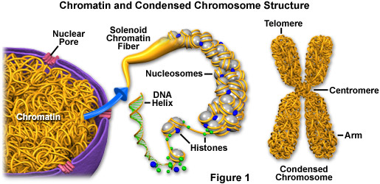
DNA in the Cell Cycle:
It is most important to understand what is happening to the cell’s DNA during the cell cycle.
G1 (Gap 1) of Interphase:
DNA exists as very long strands wrapped around histone proteins. This is called Chromatin (like a bowl of spaghetti)
DNA is checked for errors

Slide 26
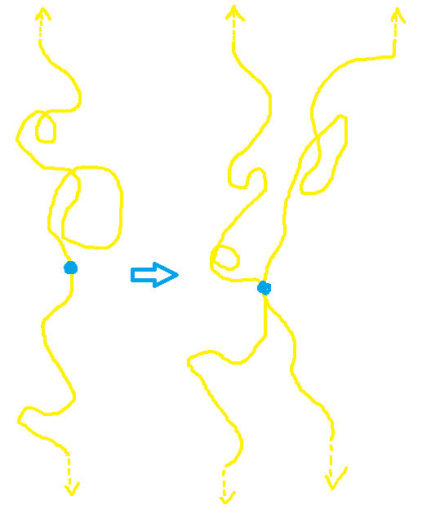
S (Synthesis) of Interphase:
Each strand of chromatin (46 in humans) is copied.
This is called replication
The 2 identical copies are now called sister chromatids and are joined at the centromere
Before S
After S

Slide 27
G2 (Gap 2) of Interphase:
All DNA is checked again to for proper replication
Prophase of Mitosis:
Chromatin condenses into chromosomes (sister chromatids)
http://supercoiling 1
http://supercoiling 2
Sister chromatids attach to spindle fibers at the centromere

Slide 28
Metaphase of Mitosis:
sister chromatids are lined up at middle of cell
Anaphase of Mitosis:
sister chromatids are pulled apart into individual chomosomes

Slide 29
Telophase of Mitosis and Cytokinesis:
Chromosomes relax back into chromatin and new cell goes into interphase

