Slide 1
Students Will:
summarize the contributions scientists have made toward the cell theory
state the cell theory.

Slide 2
Early Scientists’ Contributions

Slide 3
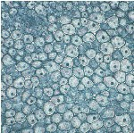
Robert Hooke
Coined the term “cell”

Slide 4
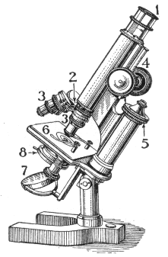
Anton van Leeuwenhoek
First compound light microscope

Slide 5
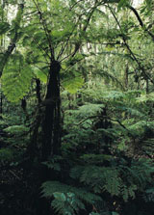
Matthias Schlieden
All plants are made of cells

Slide 6
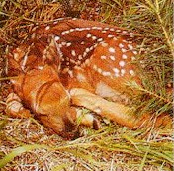
Theodor Schwann
All animals are made of cells

Slide 7
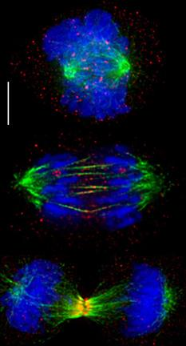
Rudolf Virchow
Cells can only arise from pre-existing cells

Slide 8
Cell Theory
The cell is the basic unit of life.
All living things are made of one or more cells.
All cells arise from pre-existing cells.

Slide 9
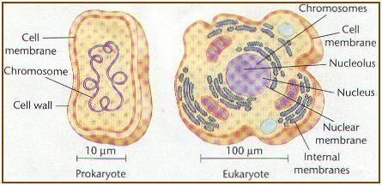
Prokaryote vs. Eukaryote
Prokaryotes= Cells WITHOUT a cell nucleus
DNA floats freely in the cell
BACTERIA are prokaryotes (and are very tiny)
Eukaryotes= Cells WITH DNA organized into cell nucleus
All plants and animals are eukaryotes
MUCH larger than tiny prokaryotes

Slide 10
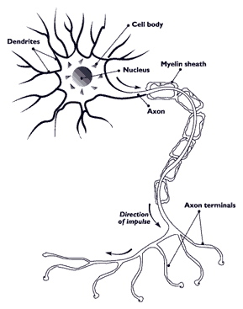
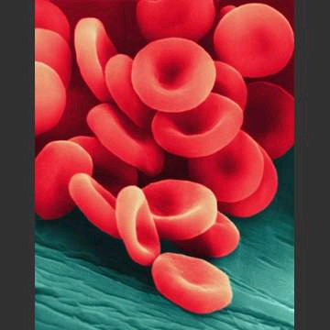
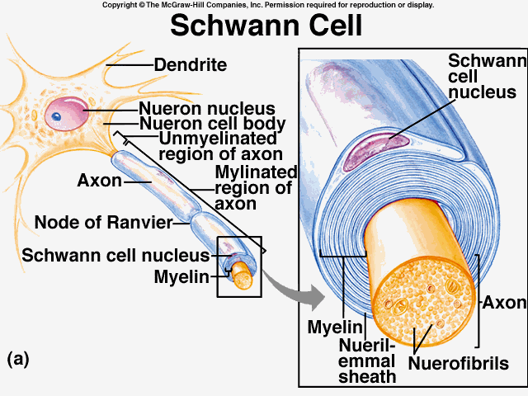
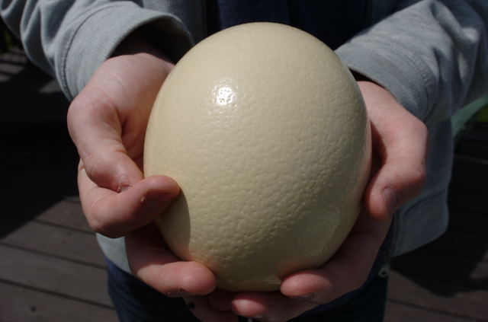
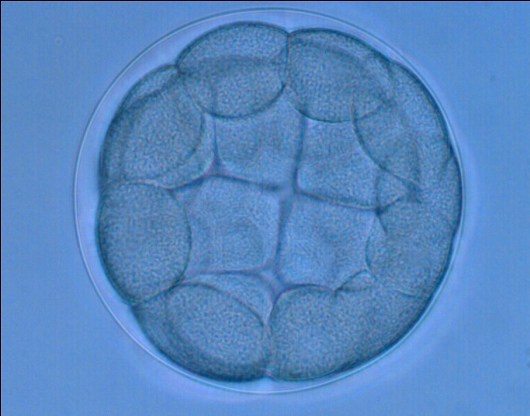
Cell Differentiation:
Differentiation: cells becoming specialized to perform different jobs
Stem cells: Cells that have NOT differentiated yet (can become anything)

Slide 11
Cells have “little organs” called-
ORGANELLES!
(See cell organelle assignment for their functions)

Slide 12
Questions...
Who used the first microscope?
Who said that plants were made of cells
Who coined the term “cell”?
Who said that all animals were made of cells?
Who said that cells must come from existing cells?

Slide 13
State the cell theory...
ALL organisms are made of one or more cells.
The cell is the basic unit of structure and function in an organism.
All cells arise from pre-existing cells.

