Slide 1
Exceptions to Basic Mendelian Rules (complex inheritance)

Slide 2
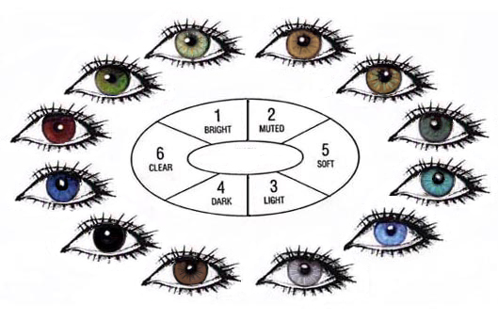
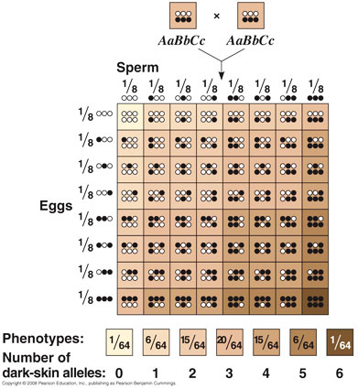
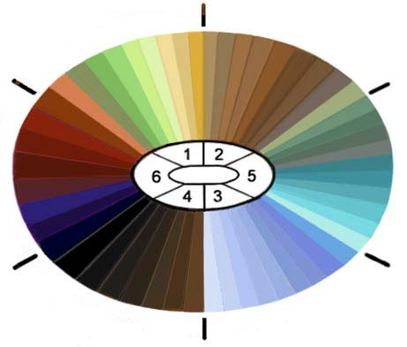
Polygenic Traits
When more than one gene contributes to the phenotype.
Creates a wide range of phenotypes
Examples – skin color, eye color, height

Slide 3
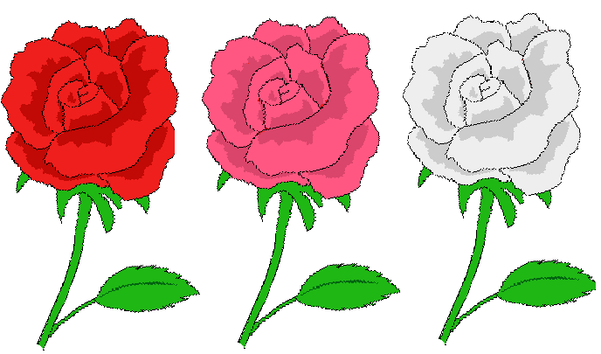
Incomplete Dominance
dominant
In incomplete dominance, neither allele is __________ so there is a blending of ______ when two different alleles for the same trait occur together.
Traits blend together
(______________ individuals = 3rd phenotype)
traits
heterozygous
red
pink
white

Slide 4
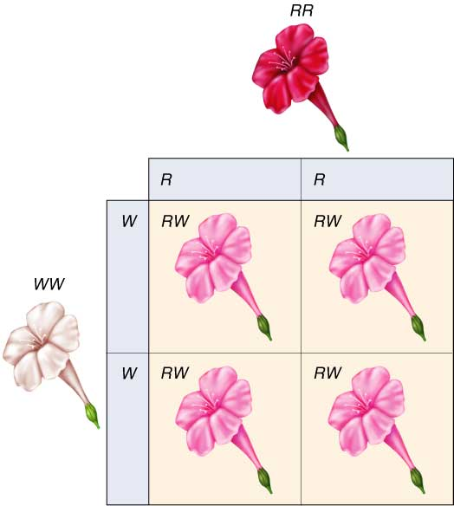
Incomplete Dominance
RR
In Four O’ Clocks, if you cross a red _____ (which is always pure) with a white _____ (that is also always pure) , you get a pink _____ (which is always hybrid / heterozygous
WW
RW
RW
RW
RW
RW

Slide 5
Incomplete Dominance
RR
BB
In another flower, if red ____ and blue ____ flowers are crossed, they produce a 3rd purple ____ flower
What would be the genotype ratio and phenotype ratio if you crossed two purple flowers?
RB
Notes:
http://www.gwu.edu/~darwin/BiSc150/One/rose.GIF

Slide 6
Incomplete Dominance
Cross of two purple flowers ____ X ____
What are gamete possibilities?
genotype ratio
1RR : 2RB : 1BB
phenotype ratio
1red : 2 purple : 1 blue
Can you have a heterozygous red or hybrid blue flower? ___
RB
RB
R
B
RR
RB
R
red
purple
RB
BB
B
purple
blue
no
Notes:
http://www.gwu.edu/~darwin/BiSc150/One/rose.GIF

Slide 7
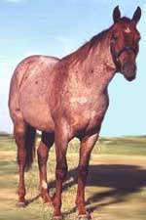
Codominance
Both _______ contribute to the phenotype of the organism by showing up simultaneously (at the same time) in heterozygous individuals.
alleles
In cattle and horses, if you cross a pure ____ (RR) with a pure ______ (WW), you get (RW) which produces the color _____.
red
white
roan

Slide 8
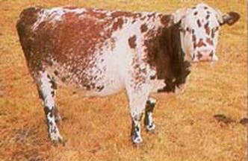
Codominance
These cattle or horses actually have both red and white hairs intermixed, or are spotted. Roan is a third ___________.
If you cross a roan with a white…
phenotype
R
W
RW
WW
W
roan
white
RW
WW
W
roan
white
Notes:
http://www.ccs.k12.in.us/chsteachers/Amayhew/Biology%20Notes/beyond%20dominance%20notes_files/image004.jpg

Slide 9
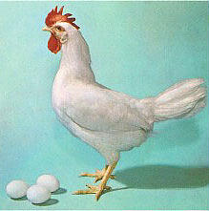
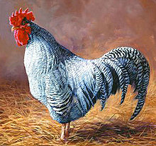
Codominance
Andalusian chickens also show this pattern of inheritance.
If you cross a black (BB) chicken
With a white (WW) chicken
You get black+white speckled (BW) chicken

Slide 10
Multiple Alleles
In this pattern of inheritance, the genes have more than _____ alleles controlling them and are therefore said to have multiple alleles. No individual has more than _____ alleles, but there are more than _____ possible alleles in a population, so a ______ will be expressed in more than two forms.
two
two
two
trait

Slide 11
Multiple Alleles
Blood type in humans is an example of this inheritance pattern.
The ______ different blood groups:
A, B, O, and AB
Are produced by ______ different alleles:
A, B, and O
Phenotype | Genotype
A | AA or AO
B | BB or BO
AB | AB only
O | OO only
four
three

Slide 12
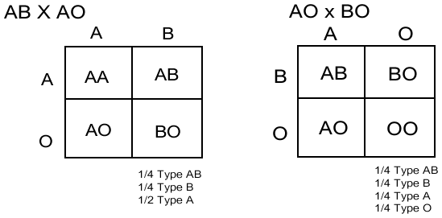
Multiple Alleles
Examples of Blood type crosses

Slide 13
Multiple Alleles
Blood Groups
Phenotype
(Blood Type
Antigen on
Red Blood Cell
Safe Transfusions
Genotype
To
From

Slide 14
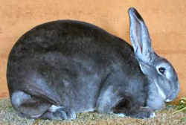
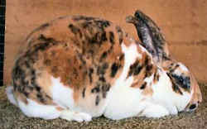
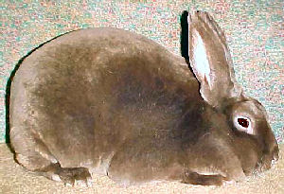
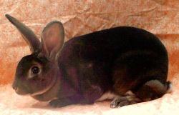
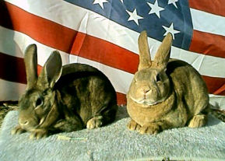
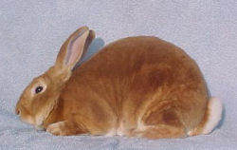
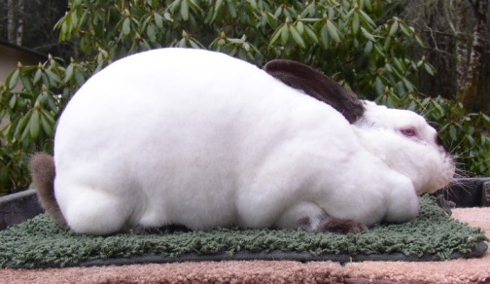
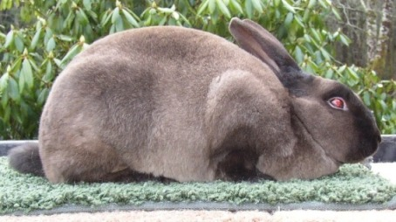
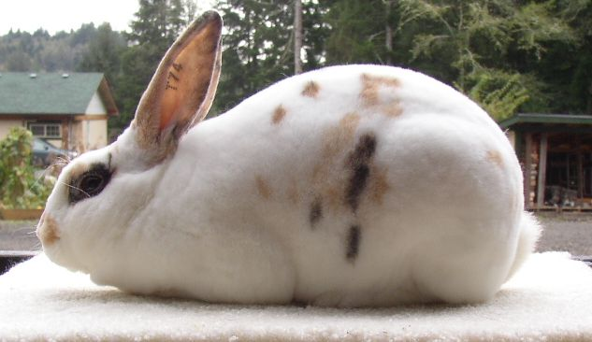
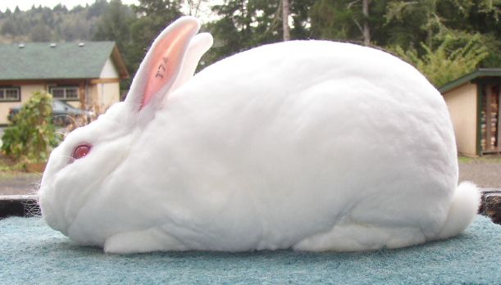
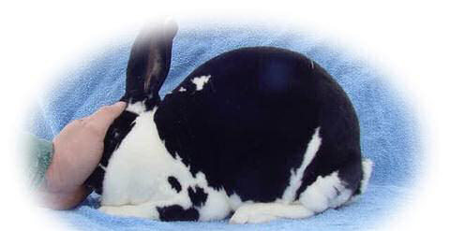
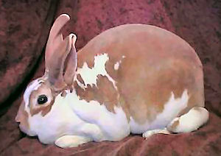
Multiple Alleles
rabbit
The example of _______ hair color, which has at least four different alleles, (on text pg 273) is seen in these different Rex rabbits.

Slide 15
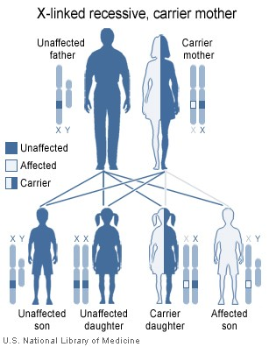
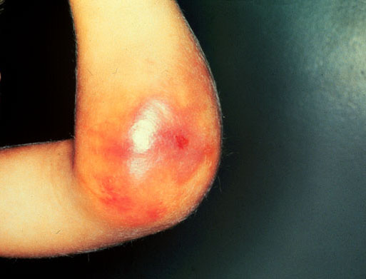
Sex Linked Traits
Traits whose genes are found on the sex chromosomes (X or y)
Traits will occur more frequently in one gender
(ex- Hemophilia, a blood clotting disease whose gene is found on the X chromosome)

Slide 16
Practice 1
Let’s assume that dragons show incomplete
dominance for fire breathing. The F allele provides
lots of fire and the F’ allele gives no fire.
If a dragon that has very strong fire is crossed with a dragon that has moderate fire, what will
their offspring be like?
Under what conditions can a baby dragon be born that never has fire? Justify your
answer with Punnett Squares.
What type of dominance is this?

Slide 17
Practice 2
Let’s say that the color of merpeople’s tail is
controlled by a codominant gene and the alleles
are blue (B) and green (G).
Show a cross between two merpeople who have
bluish and green spotted tails (BG).
Give the offspring phenotypes with percentages.
What type of inheritance is this?

