Slide 1
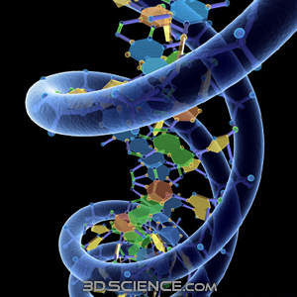
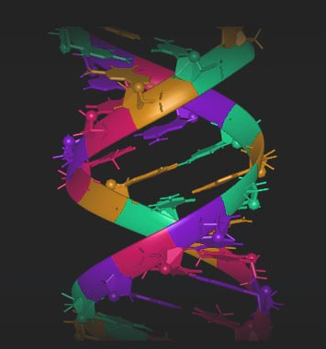
DNA: Structure and Replication
“DNA” stands for:
Deoxyribonucleic acid
DNA is made of “building blocks” called:
Nucleotides

Slide 2
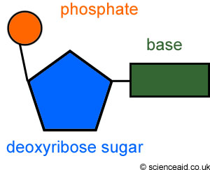
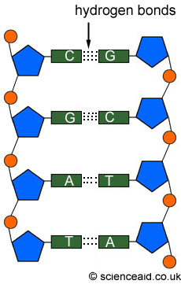
Nucleotides:
Made of 3 parts:
1.Deoxyribose (a sugar)
2.Phosphate
3.Nitrogen bases (4 different kinds)
Adenine
Thymine
Cytosine
Guanine

Slide 3
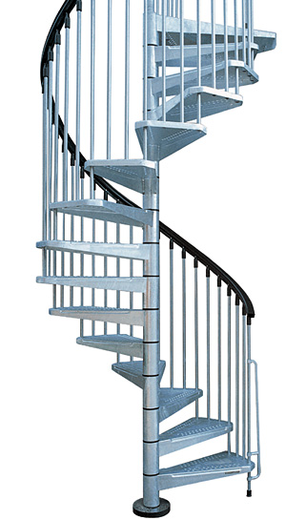
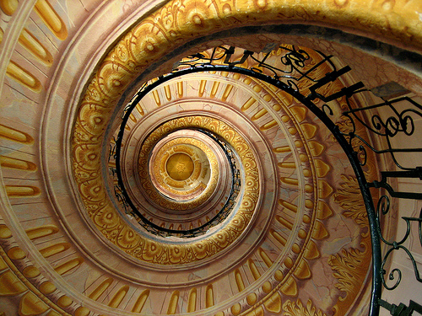
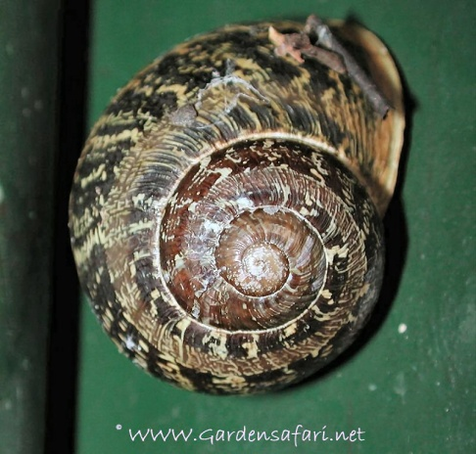
The Shape of DNA:
DNA is said to be a “Double Helix”
(think of a spiral staircase, or a little more accurately, a twisted ladder)
Helix aspersa (garden snail)

Slide 4
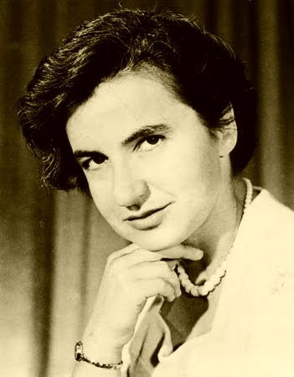
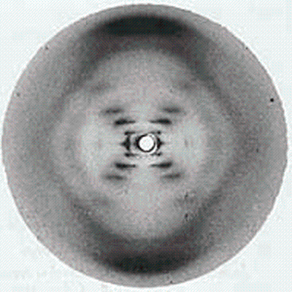
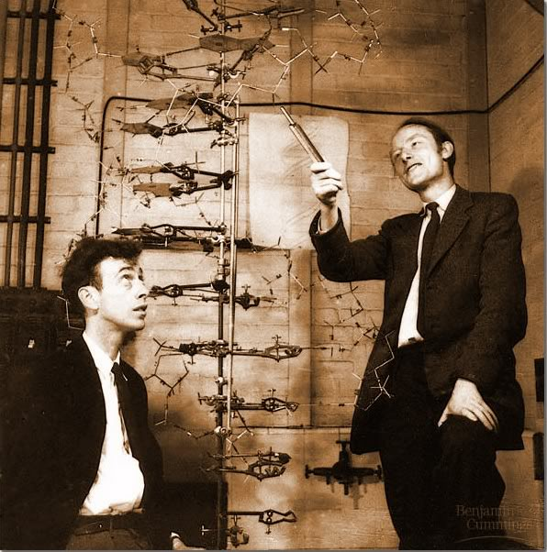
The Shape of DNA:
Rosalind Franklin and her X-ray photo of DNA
Watson and Crick and their DNA model

Slide 5
More about the “twisted ladder”
*
The phosphate of one nucleotide bonds with deoxyribose of the next nucleotide to form the sides of the ladder
*Notice the sides of the ladder run in opposite directions. This is called
anti-parallel.
*
The nitrogen bases bond with each other across the center to form the rungs of the ladder

Slide 6
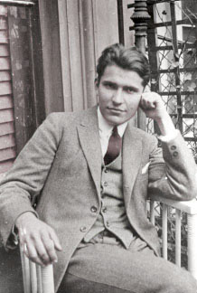
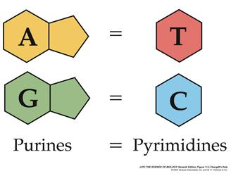
Chargaff’s Rule
Chargaff’s Rule:
In the 1940’s Erwin Chargaff did several experiments in which he examined many samples of DNA. He found that in any sample, the amount of adenine was always equal to the amount of thymine and the amount of cytosine was always equal to the amount of guanine. Thus, he surmised that in a DNA molecule, cytosine bases bonded with guanine and adenine molecules bonded with thymine.
Adenine only pairs with Thymine
Guanine only pairs with Cytosine

Slide 7
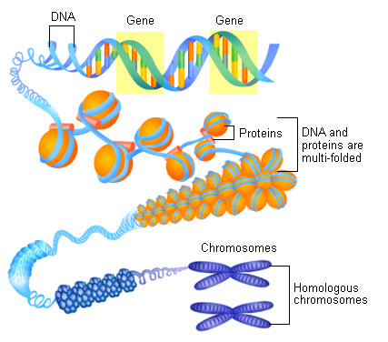
Supercoiling
When DNA is uncoiled, each chromosome would be 5 ft long! In order to make sure it can fit in tour nucleus, the DNA coils up in a few different ways
DNA becomes more tightly wound in it’s double helix shape
The DNA then winds itself around protein structures called histones
The histones then coil up until they are as compact as possible
The compact structure now coils up twice more to form chromosomes

Slide 8
Video
This video is about DNA Structure and how it works as a code for life
DNA Video

Slide 9
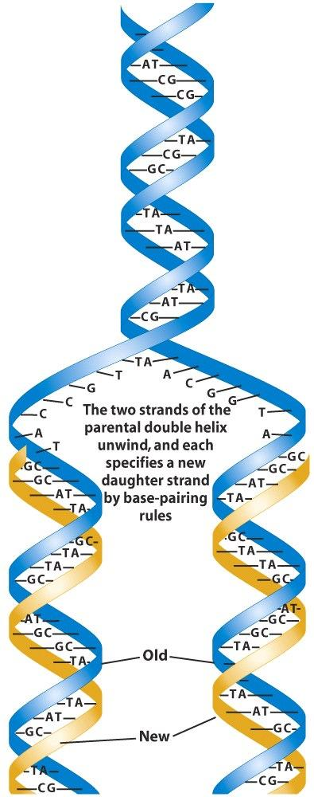
Replication of DNA-
Replication is the process of making exact copies of DNA
Why is this important?
CELL DIVISION!
QUICK QUIZ:
In what part of the cell cycle does replication occur?
INTERPHASE
In which part of interphase does replication occur?
S (synthesis) phase

Slide 10
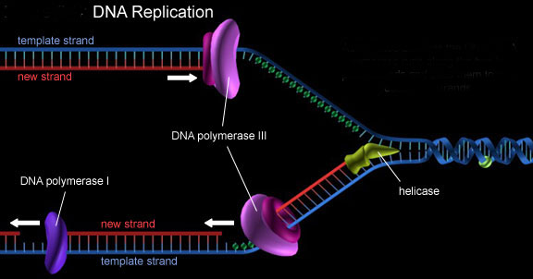
Process of Replication
Enzyme called helicase “unzips” the DNA
Enzyme called DNA polymerase attaches the appropriate free nucleotides of the open strands and travels along matching the appropriate base pair.
Replication is called semi-conservative (half of the original DNA strand is kept and the other half is new)
Quick Quiz-
What rule must the DNA polymerase follow?
Chargaff’s Rule- A=T C=G

Slide 11
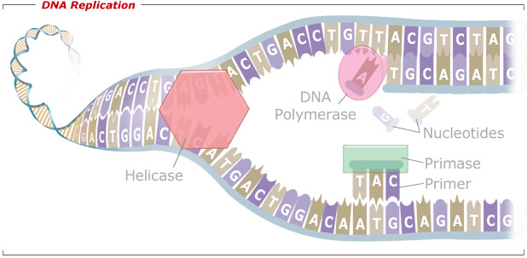
Process of Replication

Slide 12
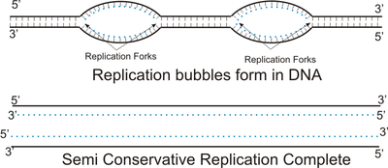
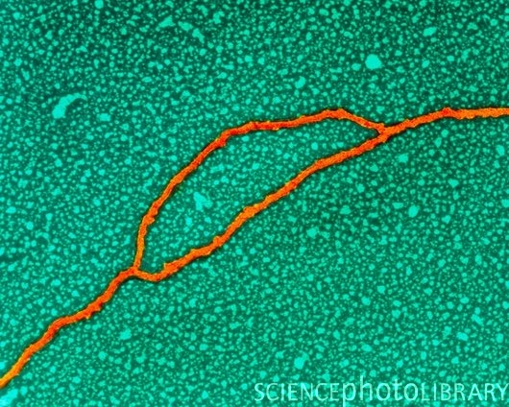
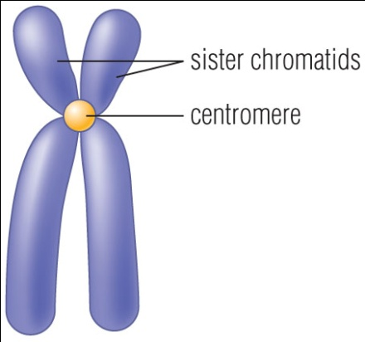
Process of Replication
To speed the process, helicases work in both directions forming “replication bubbles”
There are replication bubbles at MANY points along the chromosome
Quick Quiz-
What is the result when the DNA of one entire chromosome has been replicated?
SISTER CHROMATIDS!

Slide 13
Replication Videos
DNA Replication Video

