Slide 1
DNA Modeling
How to make your own DNA

Slide 2
Step 1-Background Information
Read the first page and answer the pre-lab questions
Use your own sheet of paper for this.

Slide 3
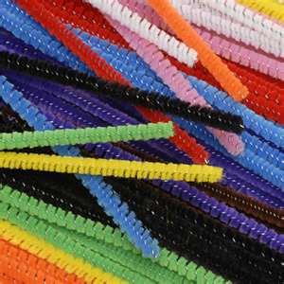
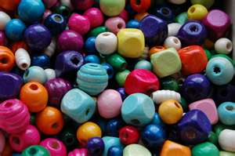
Step 2-Gather your materials
Two 12” pipe cleaners-same color
10 cut pipe cleaner pieces, all the same color
4 different colors of beads
10 of color 1
10 of color 2
5 of color 3
5 of color 4

Slide 4
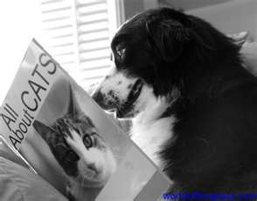
Step 3-Read through the procedure
Read through all of the steps before you begin!

Slide 5
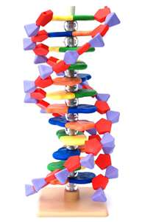
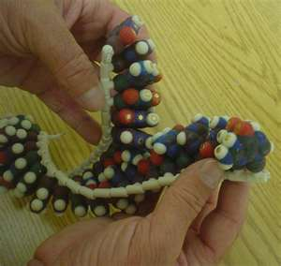
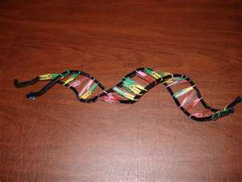
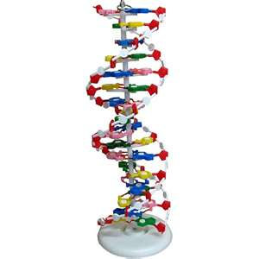
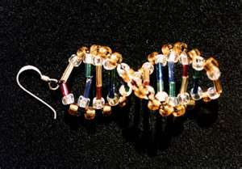
Step 4-Build your model!

Slide 6
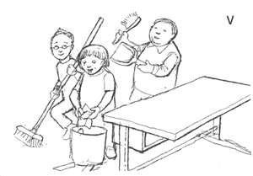
Step 5-Post-lab questions/Clean up
Answer the 5 post-lab questions on the same sheet as your pre-lab questions.
Make sure any extra supplies are put away
Using masking tape, put your name on your model

