Slide 1
Changes in Ecosystems: Ecological Succession

Slide 2
Definition:
Natural, gradual changes in the types of species that live in an area; can be primary or secondary.

Slide 3
Primary Succession
Begins after a major disturbance in a place with no soil
Sides of volcanoes
Landslides
Flooding
After glaciers melt
Starts with the arrival of living things such as lichens that do not need soil to survive
Called PIONEER SPECIES

Slide 4
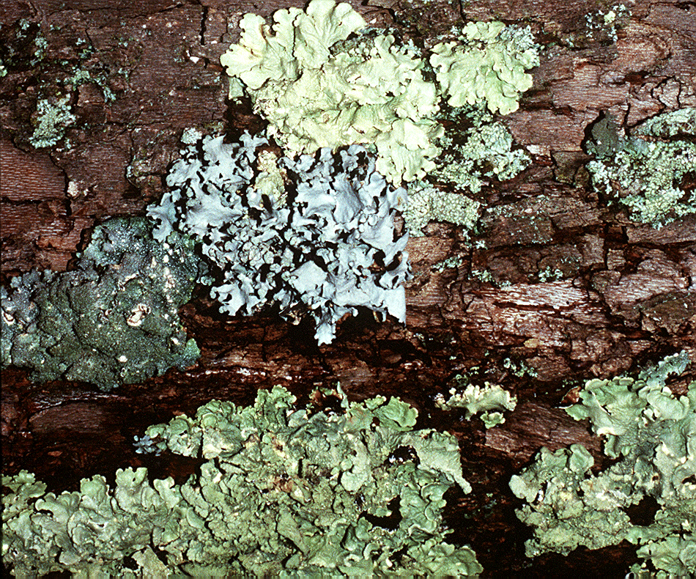
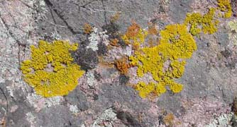
http://botit.botany.wisc.edu
http://www.saguaro-juniper.com/

Slide 5
Primary Succession
Soil starts to form as lichens and the forces of weather and erosion help break down rocks into smaller pieces
When lichens die, they decompose, adding small amounts of organic matter to the rock to make soil

Slide 6
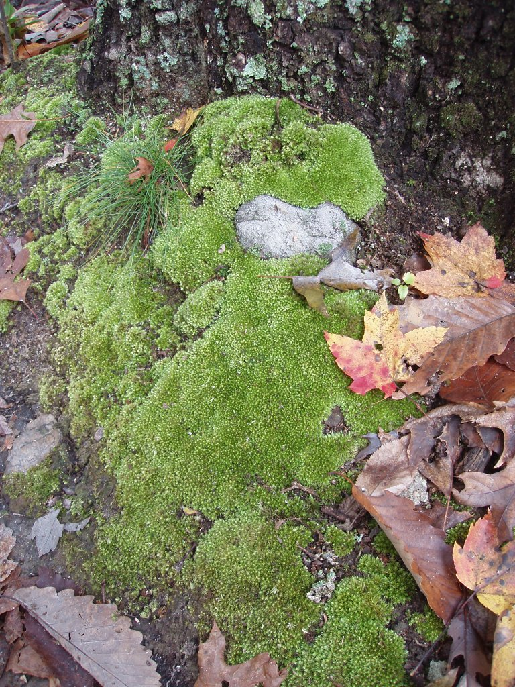
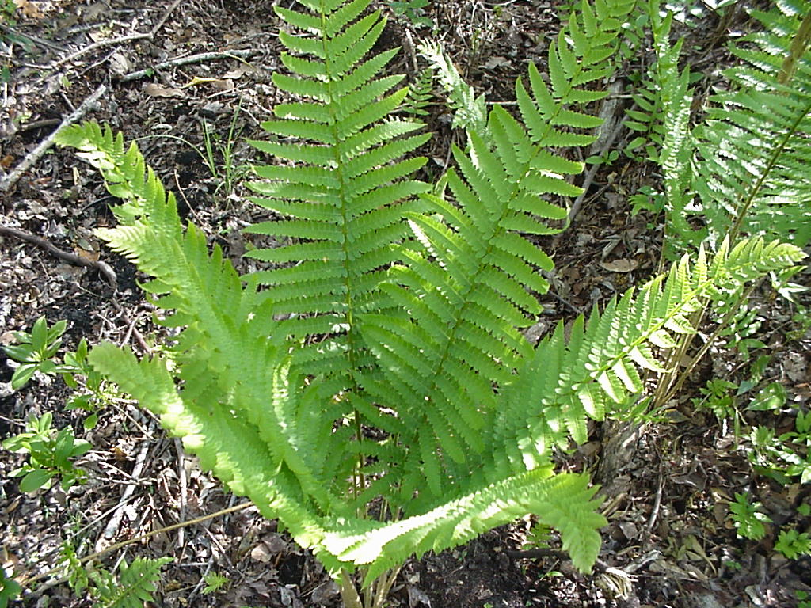
Primary Succession
Simple plants like mosses and ferns can grow in the new soil
http://www.uncw.edu
http://uisstc.georgetown.edu

Slide 7
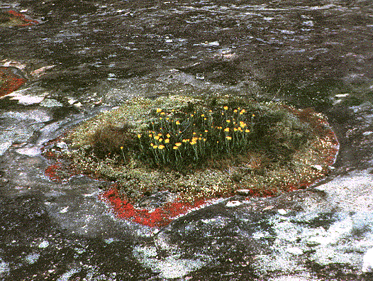
http://www.life.uiuc.edu

Slide 8
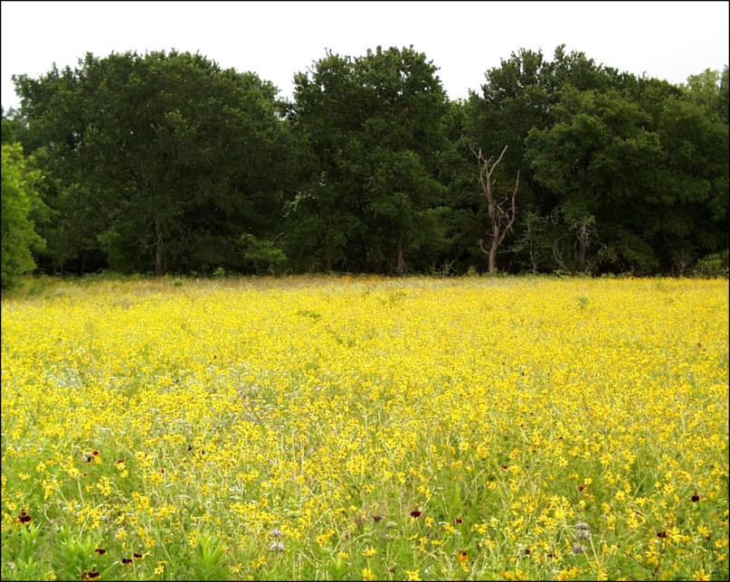
Primary Succession
The simple plants die, adding more organic material
The soil layer thickens, and grasses, wildflowers, and other plants begin to take over
http://www.cwrl.utexas.edu

Slide 9
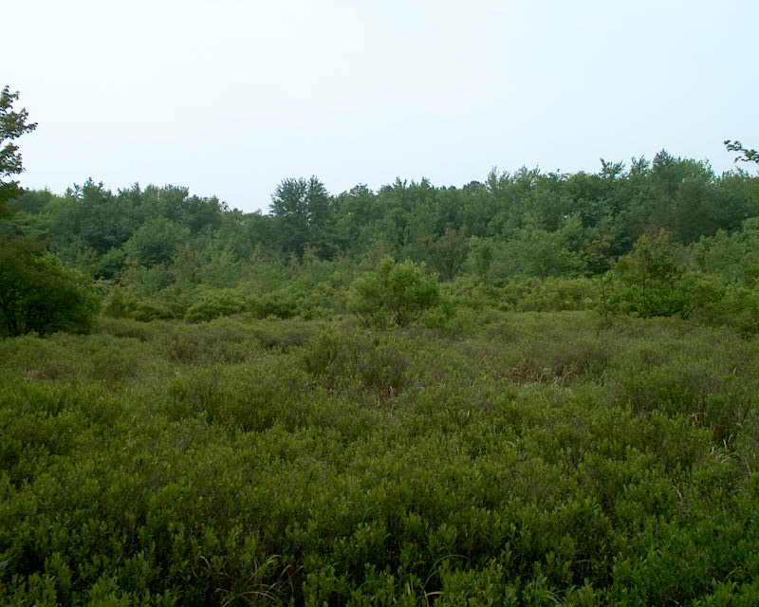
Primary Succession
These plants die, and they add more nutrients to the soil
Shrubs and trees can survive now
http://www.rowan.edu

Slide 10
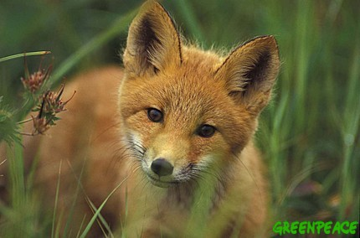
Primary Succession
Insects, small birds, and mammals have begun to move in
What was once bare rock now supports a variety of life
http://p2-raw.greenpeace.org

Slide 11
Secondary Succession
Begins after a disturbance in a place that already has soil and was once the home of living organisms
Occurs faster and has different pioneer species than primary succession
Example: after forest fires or abandonded farms

Slide 12
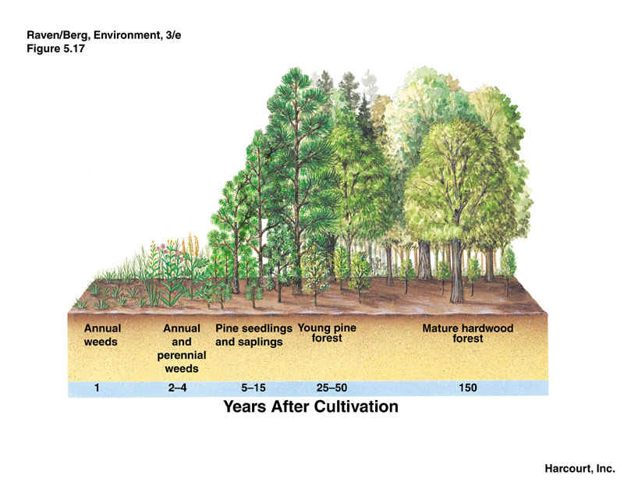
http://www.ux1.eiu.edu

Slide 13
Climax Community
A stable group of plants and animals that is the end result of the succession process
Does not always mean big trees
Grasses in prairies
Cacti in deserts

