Slide 1
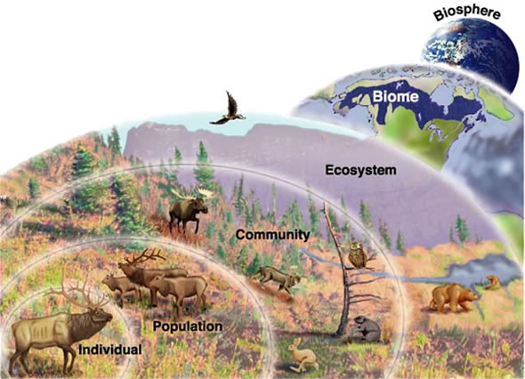
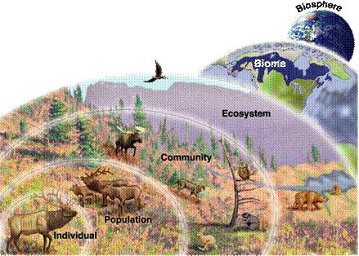
Ecology:
Levels of Organization

Slide 2
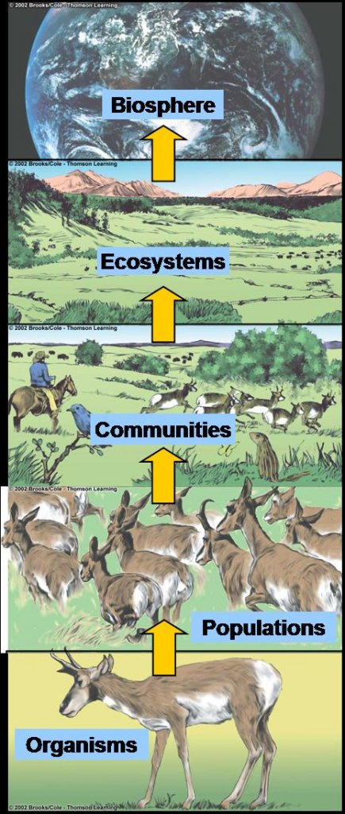
ECOLOGY is the study of the interactions and relationships between biotic and abiotic factors.
Biotic= living things
Abiotic= NON-living things
There are 5 main levels →

Slide 3
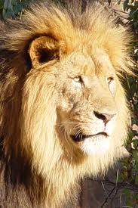
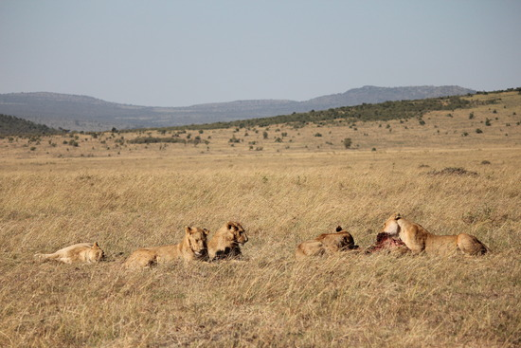
1. Organism: One individual of a particular species
2. Population: all of the individuals of one species in an area.

Slide 4
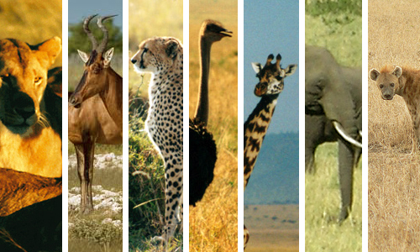
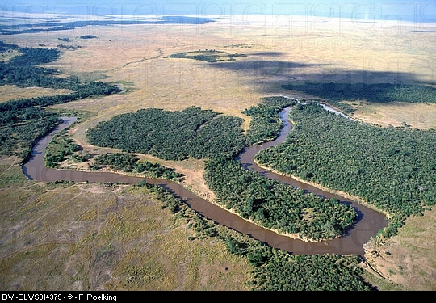
3. Community: All of the populations of biotic (living) things in a place.
4. Ecosystem: All of the biotic (living) and abiotic (nonliving) things in an environment.

Slide 5
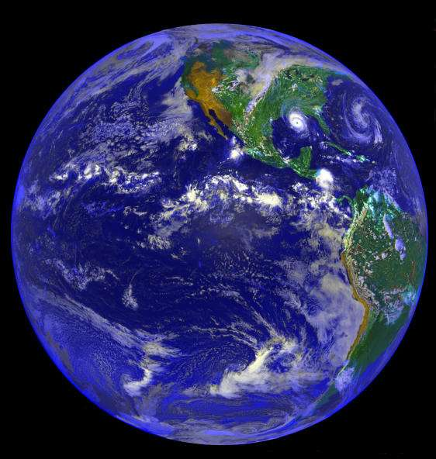
5. Biosphere: All of the places on a planet where life can exist.

Slide 6
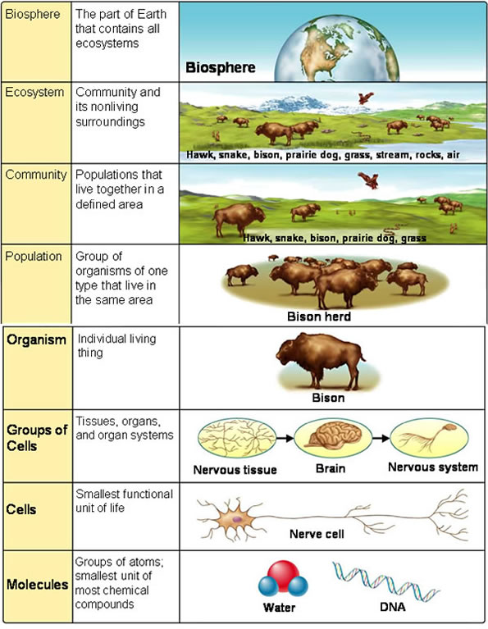
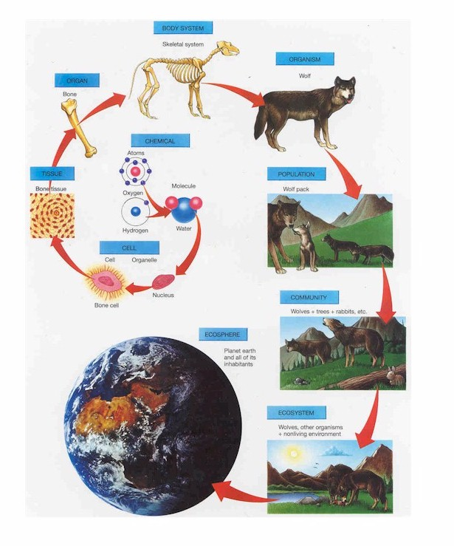
ECOLOGY
ECOLOGY

Slide 7
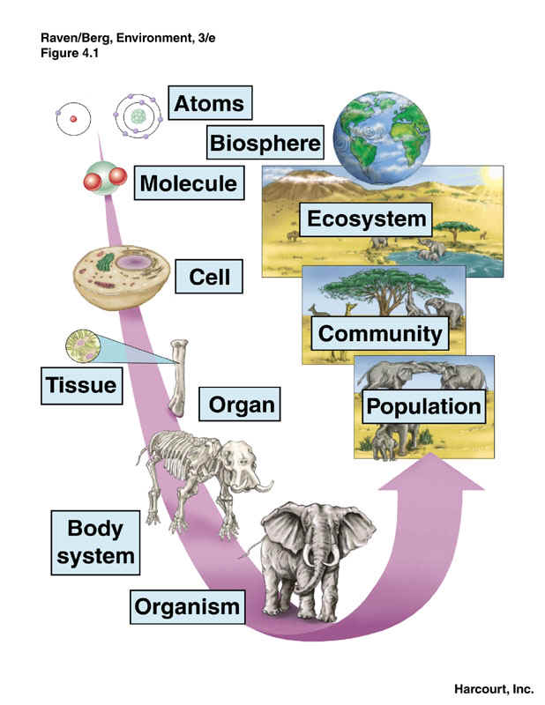
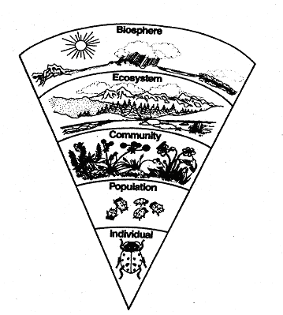

Slide 8
Levels of Ecology Poster Assignment:
You will use a double sized sheet of paper to make a poster. You can design it however you want as long as it:
-displays the levels of oganization in correct order .
-contains definitions of all levels.
-is in color.
-is titled “Levels of Ecology”
You can start with any organism of your choice.

