Slide 1
Exotic and Invasive Species
Exotic—organisms that have been introduced by human activity into an ecosystem where they are not native.
Invasive species—exotic that spreads naturally into natural or semi-natural habitat, causing a major change in the habitat and how it functions
Exotics are introduced by human activity.
In your garden, it’s not invasive; in the woods, it is.

Slide 2
Exotic and Invasive Species
How do they get there?
1. Accidental introduction
2. Purposeful introduction and accidental spread
3. Purposeful introduction and spread
4. Expanding range because humans have changed the area

Slide 3
Exotic and Invasive Species
Bad results:
1. Out-compete native species
2. Cause disease in native species
3. Prey on native species
4. Degrade habitats—erosion, loss of soil
5. Change natural processes (natural fire protection)

Slide 4
Methods for Control
Mechanical
Use physical methods for removal
Traps for animals
Cutting down/digging out plants
Putting up barriers (fences)
Chemical
Application of herbicides (kill plants) or pesticides (kill or make animals infertile/unable to reproduce)
Used to lure animals into traps
Easy and less labor intensive, but could harm native plants and animals as well.
Biological
Release of specific species into the environment to control the invasive species
Could really help the problem without using harmful chemicals
Could have unforeseen circumstances to the environment (could become an invasive species itself.

Slide 5
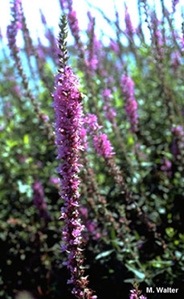
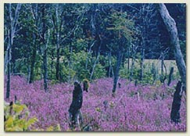
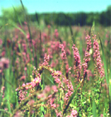
Purple Loosestrife
Attractive flower was used in landscaping
Reproduces by cuttings, roots, and seeds. One plant can produce 300,000 seeds in a year.

Slide 6
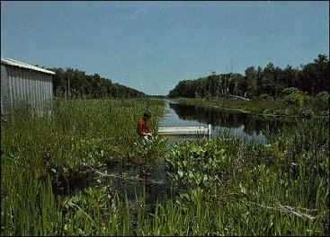
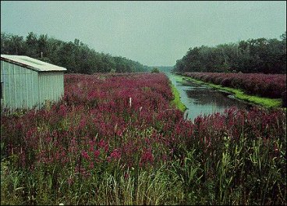
Purple Loosestrife, cont.
So aggressive that it chokes out native plants, destroying wildlife habitat.
1968, major waterfowl nursery
1978, most natives destroyed or displaced by loosestrife.

Slide 7
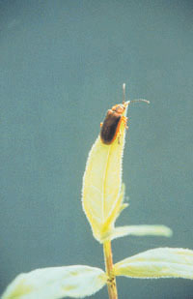
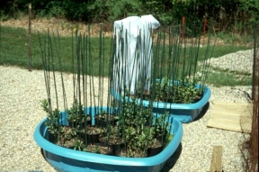
Purple Loosestrife, cont.
Minnesota DNR introduced Loosestrife beetles to control the growth of the plants
Beetles only eat loosestrife. When that runs out, they die.
Making progress on stopping loosestrife but still a long way to go.

Slide 8
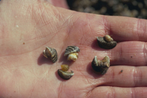
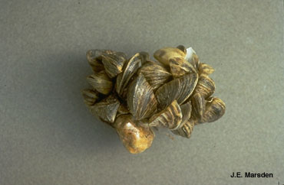
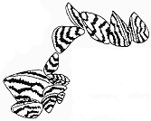
Zebra Mussels
First introduced in the Great Lakes by ballast water from ocean-going vessel. Larvae or adults can spread. Multi-billion dollar threat to industrial, agricultural, and municipal water supplies.

Slide 9
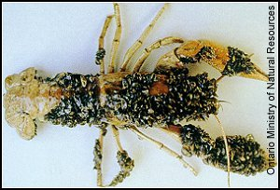
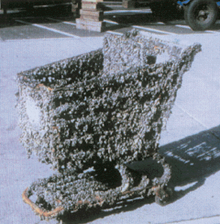
Zebra Mussels, cont.
They clog water intakes.
They out-compete native mussels.
They leave the water too clear so bottom plants and bottom-feeding fish become too common.
They encrust native species.

Slide 10
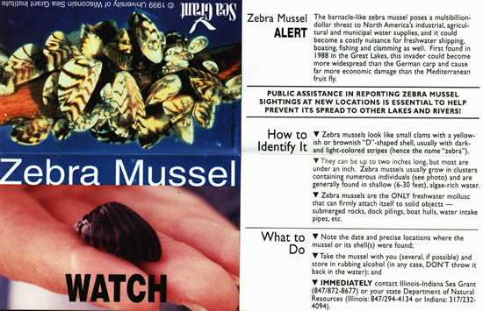
Zebra Mussels, cont.
How to stop?
Educate the public
Cards handed out at the State Fair by the DNR
Clean all boats before moving to another lake, dump livewells

Slide 11
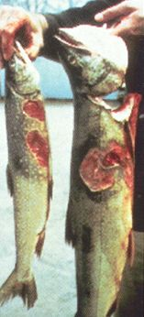
Sea Lamprey
Primitive jawless fish—has a sucker mouth
Parasite that attaches to large fish
Came into the Great Lakes from the Atlantic Ocean
Only about 1 in 7 fish survive attack by lamprey
Reduced Great Lakes commercial fishing from 15 million pounds to 300,000 pounds

Slide 12
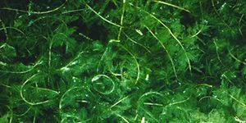
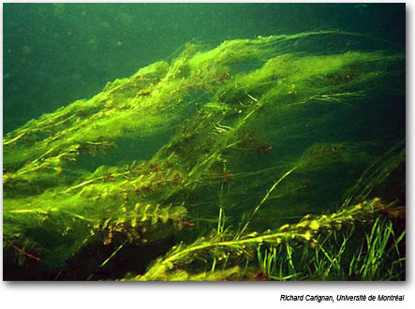
Eurasian watermilfoil
Accidentally introduced in the 1940’s
Possibly from aquarium water
First in Lake Minnetonka in 1987.
Now in over 120 lakes in the state.
Forms thick underwater mats that crowd out native plants and reduce fishing, boating, and swimming

Slide 13
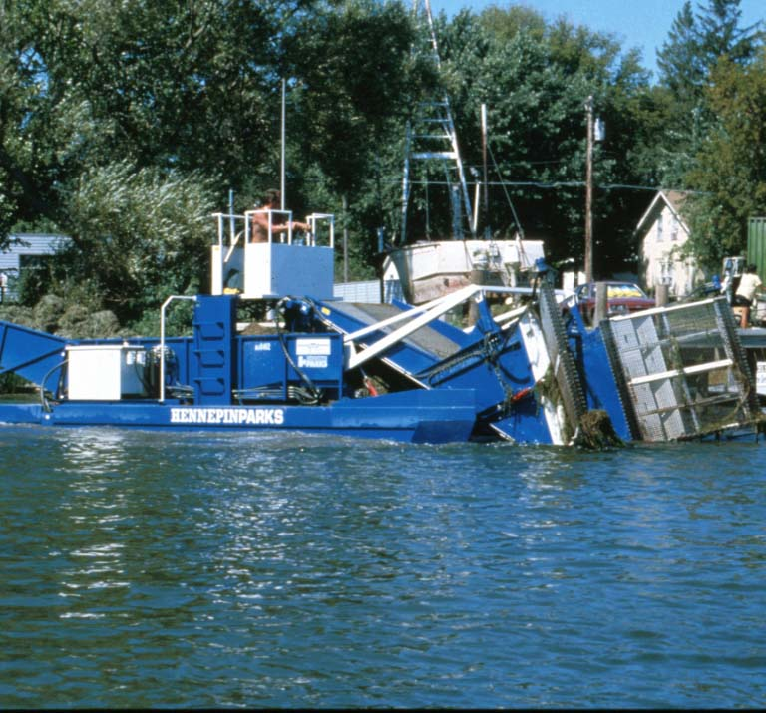
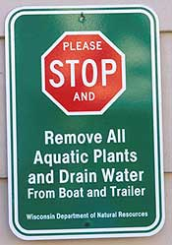
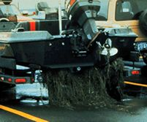
Eurasian watermilfoil
Want to remove milfoil in the water
Physical harvesters on Minnetonka
Educate the public, especially boaters
After boating—inspect, remove, drain, dispose, rinse, dry

Slide 14
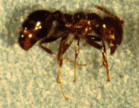
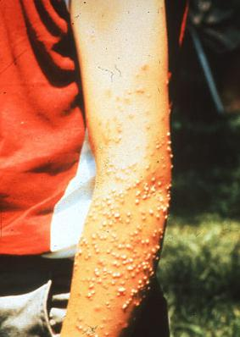
Fire Ants
Out-compete native ants
Kill many birds, reptiles, and amphibians in the egg or shortly after hatching. Kill many newborn mammals.
Nuisance to people
Found throughout southeastern US

Slide 15
Fire Ants
Originally came into port of Mobile, Alabama on ships from Brazil
Spread to other states by people moving plants and other things that have dirt with it
The government sprayed chemicals for many years but found out that the chemicals were harmful to many animals and becomes concentrated as they go up the food chain

Slide 16
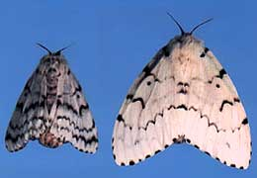
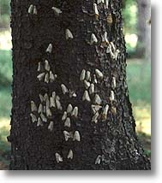
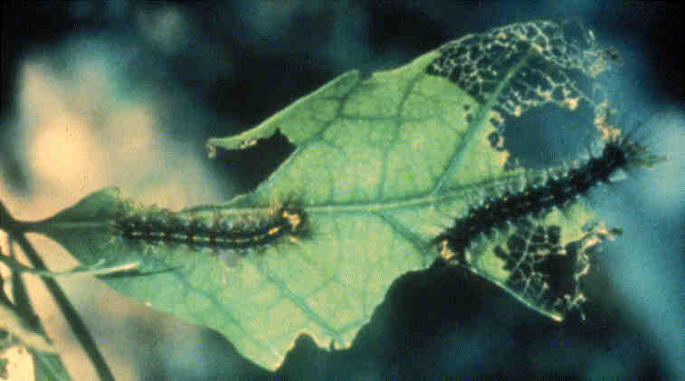
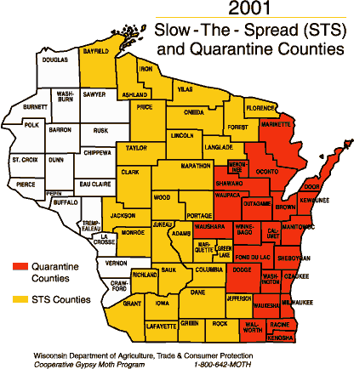
Gypsy Moths
Accidentally released in Boston in 1868.
Slow but sure spread across North America
Defoliates forests

Slide 17
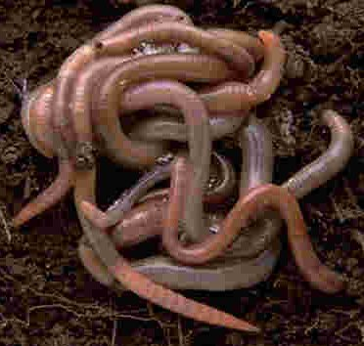
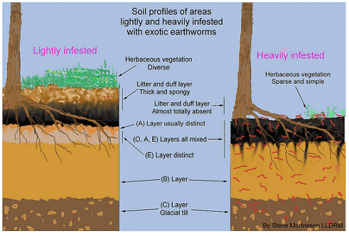
Earthworms
WHAT??? Earthworms are good! They can’t be bad!
There are no earthworms native to North America.
In the forest, they are destroying the undergrowth.

Slide 18
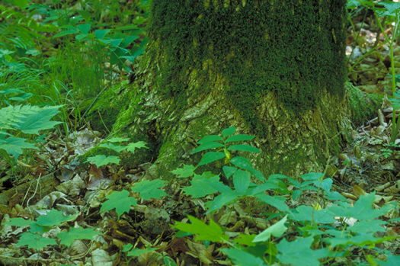
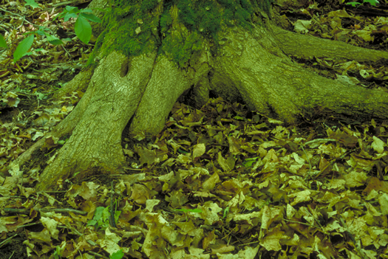
Earthworms
Without worms
With worms
What do we do to stop them?
Don’t dump extra worms near fishing spots
Educate people about the importance of not introducing worms

Slide 19
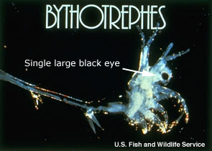
Spiny Water Flea
(Mr. Miller’s favorite example)
Came into Great Lakes through ballast water
Competes with young fish for food
Reproduces really quickly
Nobody eats it because of the “spine”
Would you?
Numbers keep going up and the other young fish have numbers going down

Slide 20
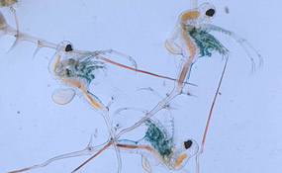
Spiny Water Flea
How do we stop them?
Good question
Start with education
Slow the spread to other lakes by cleaning boats, dumping live well

