Slide 1
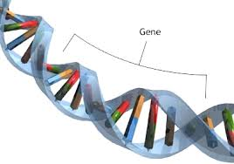
Genetics
Study of hereditary and variation of inherited characteristics

Slide 2
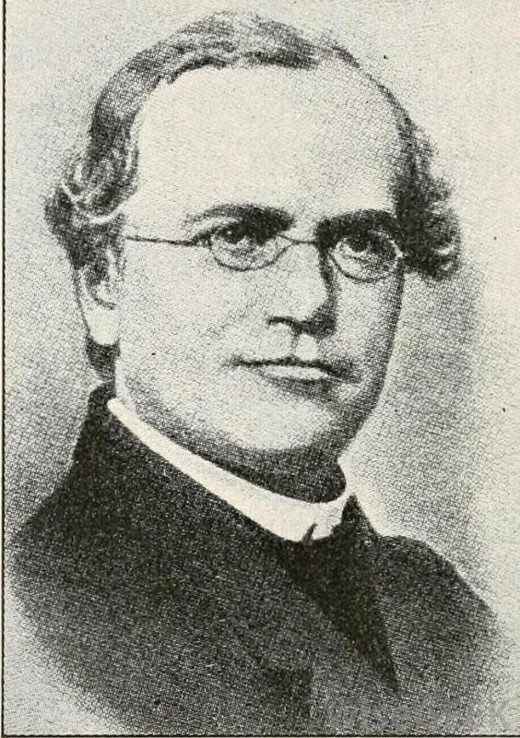
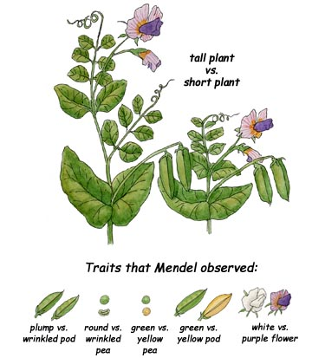
Gregor mendel (1822-1884)
Widely considered the “father of genetics” due to his work creating the Laws of Inheritance from his study of pea plants and their offspring
Found that offspring kept the traits of their parents
He called this particulate inheritance
which we now study as heredity
Heredity: Passing of characteristics from
one generation to the next

Slide 3
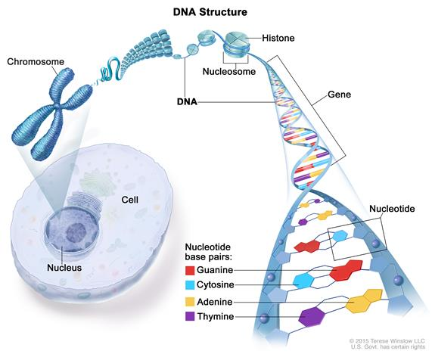
Trait: Characteristic of an individual due to what proteins are coded for.
Examples: Eye color, shriveled or not pea pod, hemophilia, fingernails.
Gene: Specific section of DNA that codes for proteins that make up our traits/characteristics
Allele: Form of a gene that a person has

Slide 4
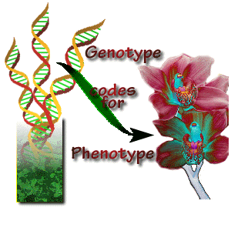
Genotype & Phenotype
You have 2 alleles for every gene. One from mom and one from dad.
Genotype: The genetic makeup of an individual for a specific trait
(what alleles they have)
What alleles for a specific gene that a person has
Alleles are denoted capitol for dominant and lower case for recessive (E and e)
Homozygous: Carries two of the same allele form
(EE)- Homozygous dominant
(ee)- Homozygous recessive
Heterozygous: Carries one of each allele form
(Ee)- Only one of the alleles will be visible as a trait

Slide 5
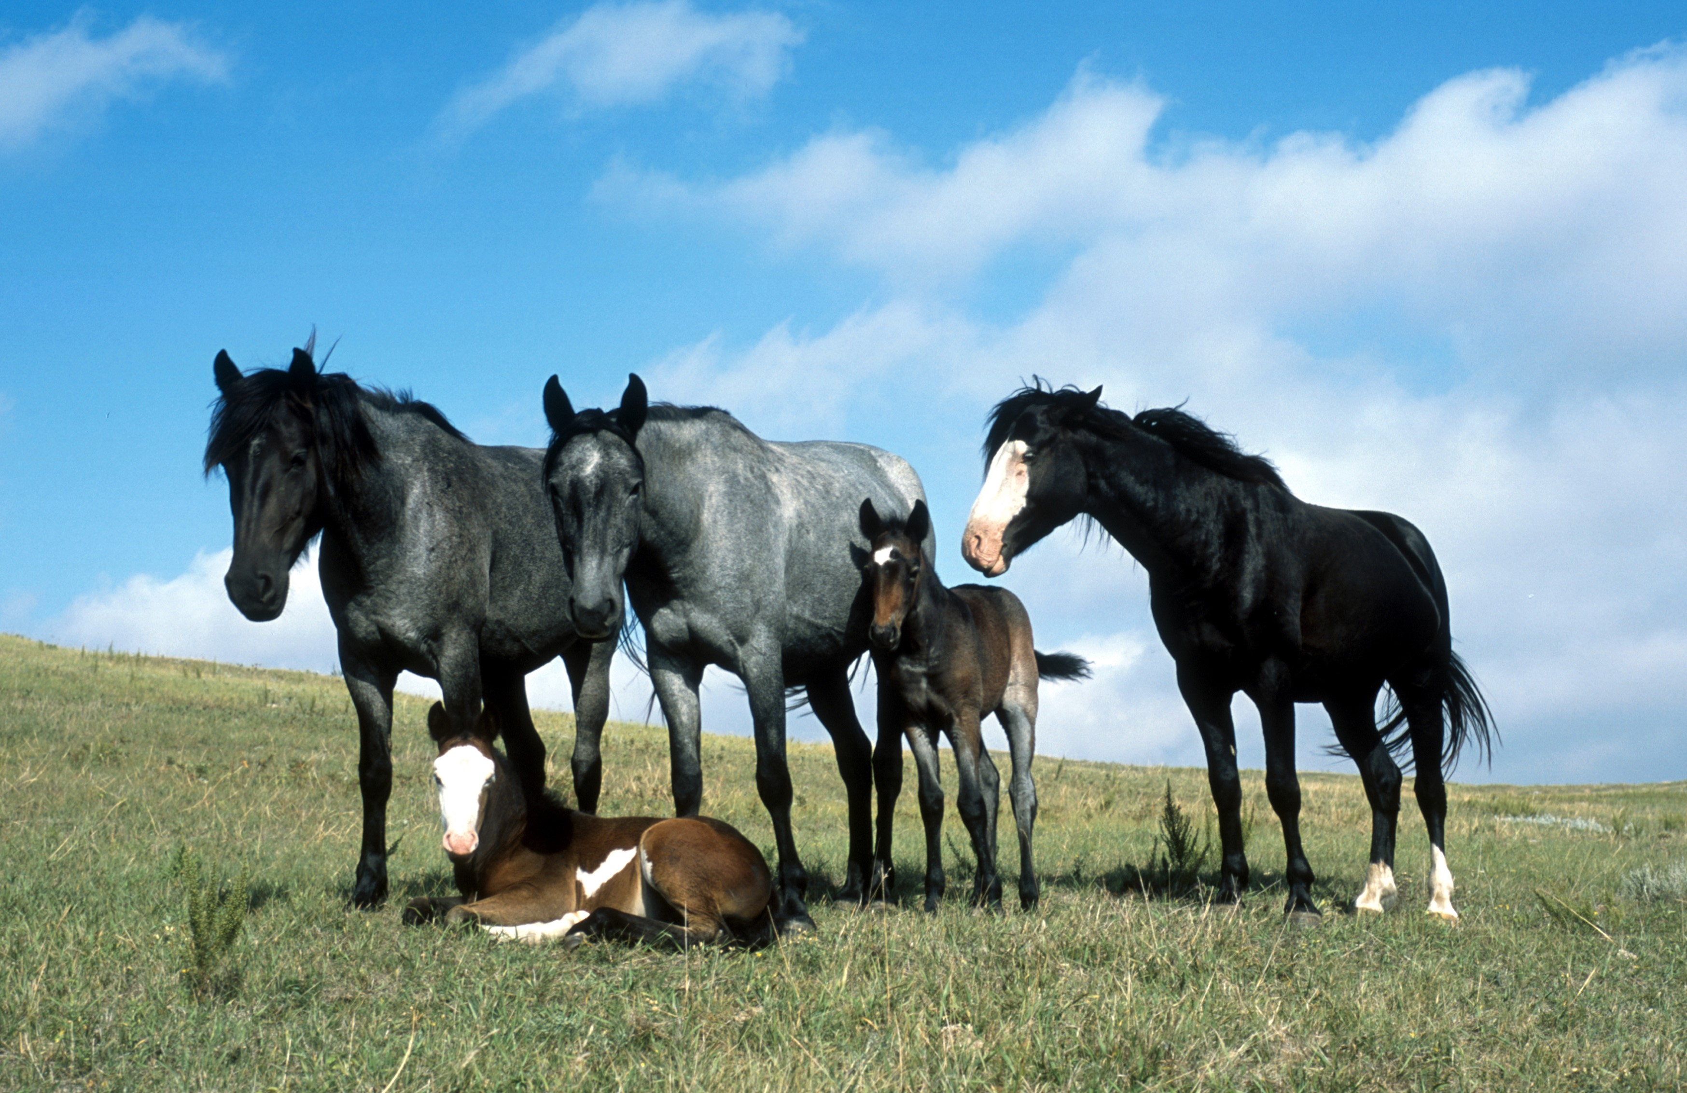
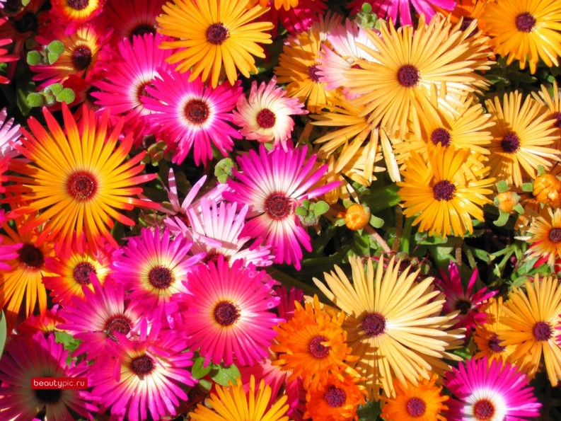
Genotype & Phenotype cont…
Phenotype: trait or characteristic that is expressed
(seen) in an individual

Slide 6
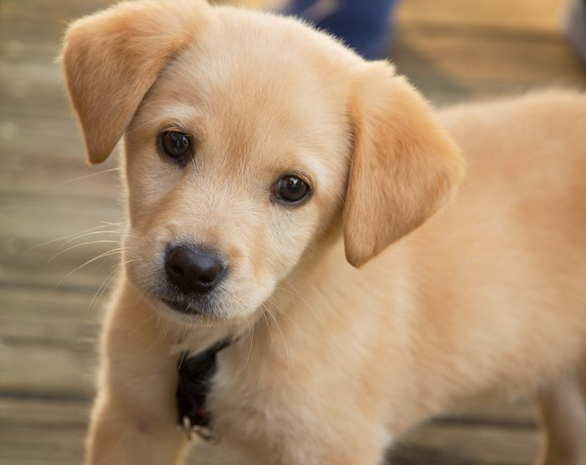
Mendelian Inheritance
Individuals have 2 alleles (version of the gene).
The different variation of alleles express different versions of a trait.
Alleles types are either dominant or recessive
If you have even 1 dominant form of the gene, THAT is the phenotype (trait) expressed.
i.e. If you are Heterozygous, you will have the dominant phenotype (trait) even if you have a (hidden) recessive gene copy from one of your parents.
Even though a trait is not seen (recessive), that trait can still be passed down to the next generation.

Slide 7
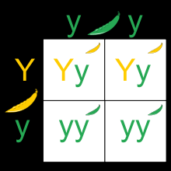
Punnett squares
Punnett squares are diagrams used to determine
(or predict) the possible genotypes of offspring
Example:
Dominant Allele Y codes for yellow pea pod
Recessive Allele y codes for green pea pod
How many offspring will be yellow pods?
How many will be green pods?

Slide 8
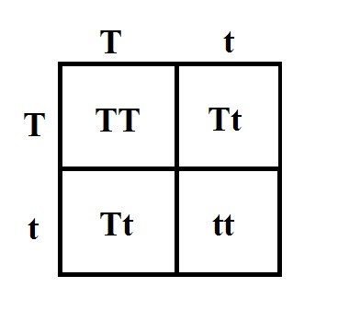
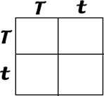
Punnett Squares
Try it!
T is the dominant allele for Tall plants
t is the recessive allele for short plants
Maternal Genotype (Tt)
Paternal Genotype (Tt)
What % offspring will be tall, what % offspring will be short?

Slide 9
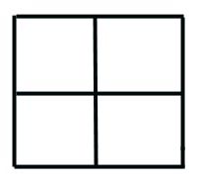
Muggles
The allele for magic in wizards is M.
M is the dominant allele of having magic
m is the recessive allele for being a muggle
Harrys mother is heterozygous for the magic allele
What is her genotype?
Harry father is homozygous dominant
What is his genotype?
What % of their children will be wizards?
Hint: Use a Punnett Square
M m
M
M

Slide 10
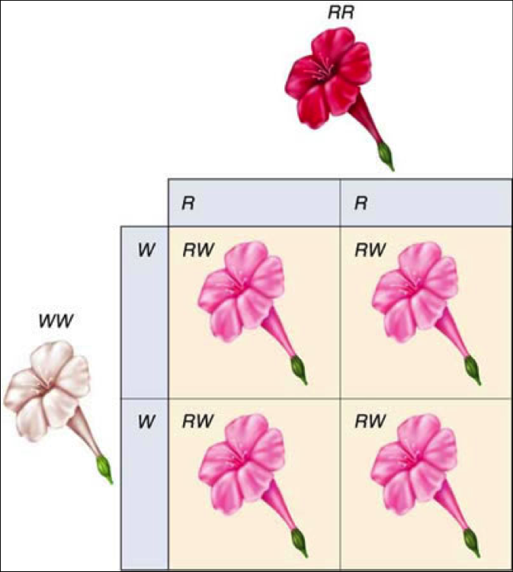
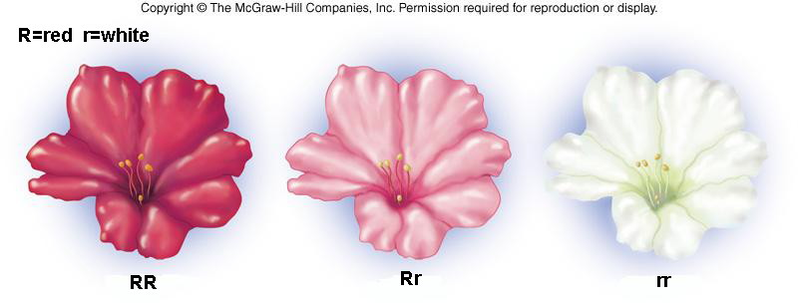
Complex Inheritance
Incomplete Dominance
When neither allele is fully dominant so the phenotype expressed is a blend of traits.
In a simple cross there will be a third phenotype

Slide 11
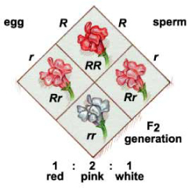
Incomplete Dominance example
Heterozygote cross for incomplete dominance flower color.
What is the ratio of flower color?
50% Pink
25% White
25% Red

Slide 12
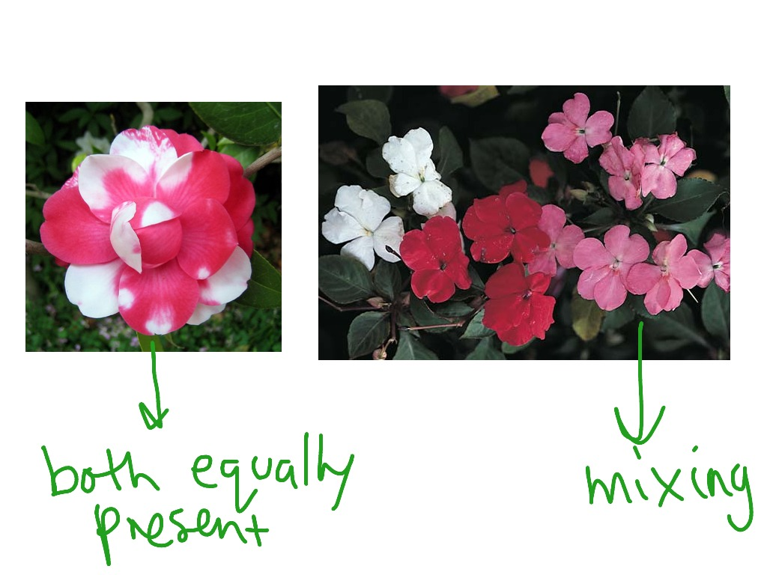
Codominance
Both alleles contribute to the phenotype and showing up simultaneously (see both traits)
Unlike incomplete dominance which blends the traits, with codominance you can see both traits expressed independently at the same time.
Codominant
Incomplete Dominance

Slide 13
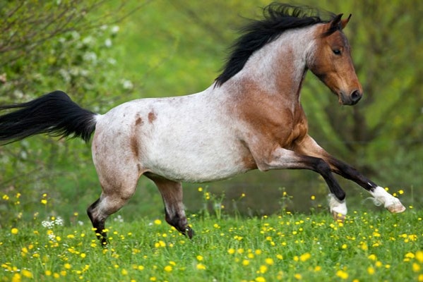
Codominance example
In Roan color horses, you can see both colors at the same time: White and Chestnut

Slide 14
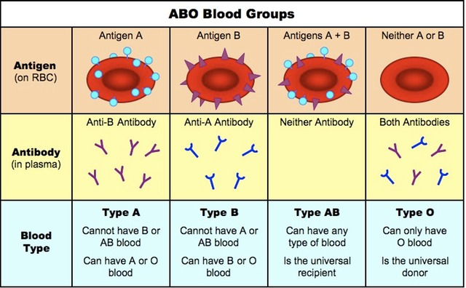
Multiple Alleles: One gene where the population has more than 2 allele versions
No individual Human carries more than 2 alleles, but many
traits have more than two possibilities for alleles in the total population.
Example: Blood Type
Allele type A, B or O
Antigen (+ or – follows typical
2 allele inheritance)

Slide 15
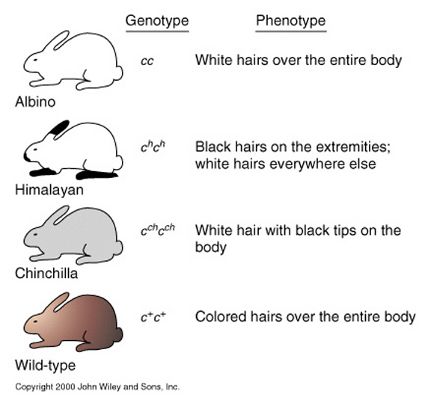
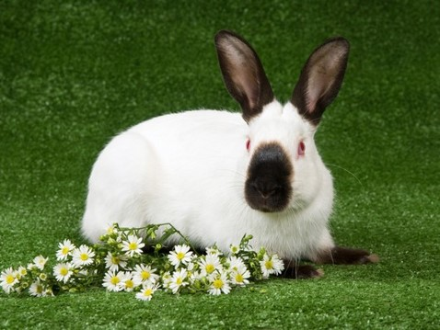
Rabbit fur: Multiple alleles example
Rabbits have five kinds of skin color, colored (agouti), chinchilla, Himalayan albino and albino, light grey.
Alleles:
C
C^h
C^ch
C^+

Slide 16
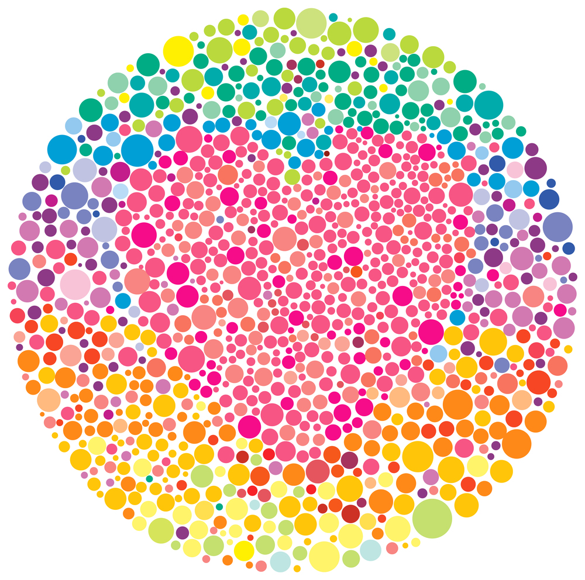
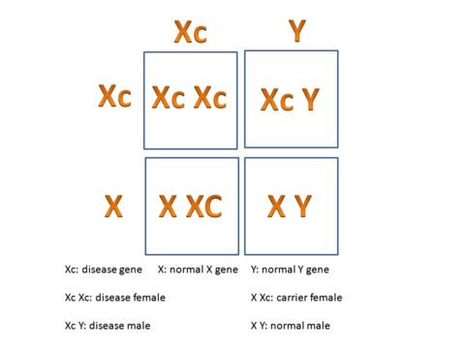
Sex-linked traits
A trait for a gene that is found only on the X or Y chromosome
Most found on X chromosome since the Y chromosome is small and carries less genetic information
Carrier: individual that inherited a recessive allele for a genetic trait or mutation but does not display that trait or show symptoms of the disease.
Example: Color blindness
Carried on X chromosome, recessive
Key Question: Can Fathers pass color blindness on to their sons?

Slide 17
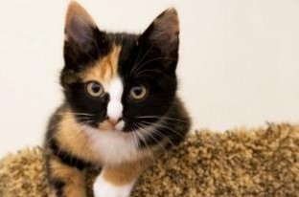
Sex-Linked example: Calico Cats Why are there no male calico cats?
Male= XY
Female= XX
One of the genes for cats coat color is located on the X chromosome.
X^B is the allele for Orange Fur (dominant)
X^b is the allele for Black Fur
Female Cats who are heterozygotes do not only express the dominant gene- they express a patchwork (tortishell) pattern of orange and black.
What are the possible female genotypes? Phenotypes?
What are the possible male genotypes? Phenotypes?
Draw the Punnett Square for a Calico Female and a Orange Male.

Slide 18
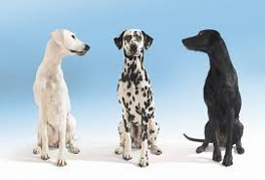
Another codominance? Not so simple……
Dalmatians spots are genetically determined by MORE THAN ONE GENE

Slide 19
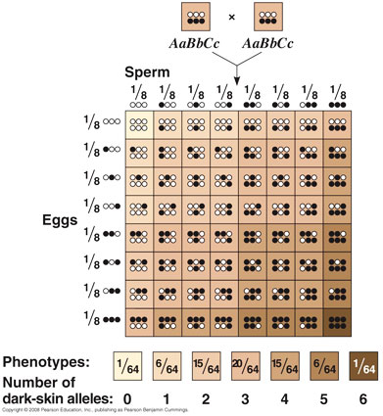
Polygenic Traits: Characteristics that are determined by the combined effect of 2+ genes
Traits that have more than one gene that codes for them
Skin color is at least 3 genes: you have 2 alleles for each gene that act as incomplete dominance pattern.
Yields a large range of phenotypes that do not follow the Mendelian expected ratios.
Poly= many
Genic = genes
MANY GENES Traits

Slide 20
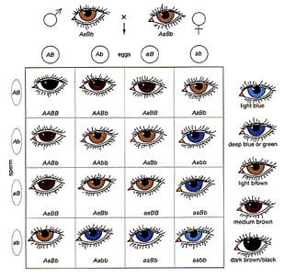
Polygenic Trait example: eye color
Eye color is controlled by more than one gene
Each gene has 2 allele options
Neither allele is fully dominant
Yields large range of possible eye colors

Slide 21
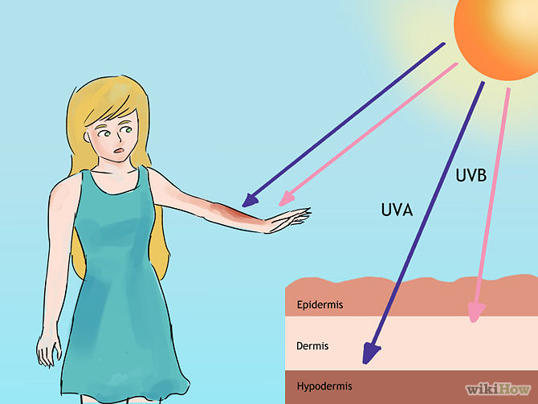
Environmental Effects on Gene Expression
Phenotype is a combination of the organisms genotype and the environmental factors surrounding the individual.
UV Exposure
Sun increases the amount of melanin produced (to protect the skin) which darkens overall skin color.
Temperature
Example: Himalayan Bunnies have an enzyme that produces black fur that is denatured by the heat of the bunnies body so only the extremities (nose, ears, feet and tail) are black.
Sex
Male baldness is effected by high levels of hormone
testosterone, which is higher in men then women.
Drugs/Chemicals
Light (wavelength/color)

