Slide 1
How Evolution Happens
Selection, Survival of the Fittest, Mutation, Genetic Drift and Gene Flow

Slide 2
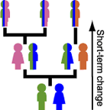
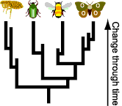
Evolution
Happens to a POPULATION not individuals
Descent with modification. (change over generations)
Evolution helps us to understand the history of life.
The central idea of biological evolution = all life on Earth shares a common ancestor, just as you and your cousins share a common grandmother.
http://evolution.berkeley.edu/evosite/evo101/IIntro.shtml

Slide 3
Natural Selection…
Can lead to changes in allele frequencies (how often you see that trait) and thus to evolution.
If the change is beneficial to the organism, the change may cause the original form to fade out and the newer organisms to be more fit and take over.

Slide 4
3 Types of Natural Selection
Directional Selection
Stabilizing Selection
Disruptive Selection

Slide 5
Natural Selection
Results in changes in the inherited characteristics of a population.
Changes increase a species’ fitness (ability to survive and reproduce) in its environment.
Natural Selection causes struggles for existence and survival of the fittest.
Natural Selection acts on the phenotype rather than the genotype of a species.

Slide 6
Directional Selection
Directional Selection – Evolution causes an increase in the number of individuals with the trait at one end of the curve.

Slide 7
Stabilizing Selection
Individuals in the center of the curve and more fit and thus the curve narrows

Slide 8
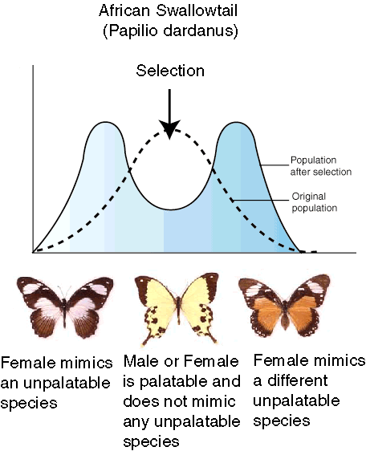
Disruptive Selection
Individuals at the ends of the curve are more fit than the ones in the middle causing two curves to form and possible new species to form.

Slide 9
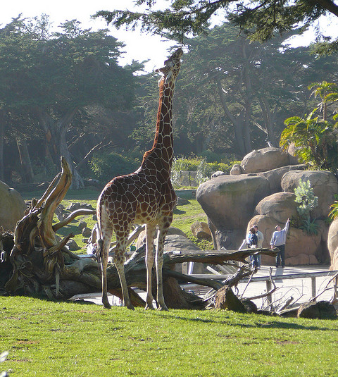
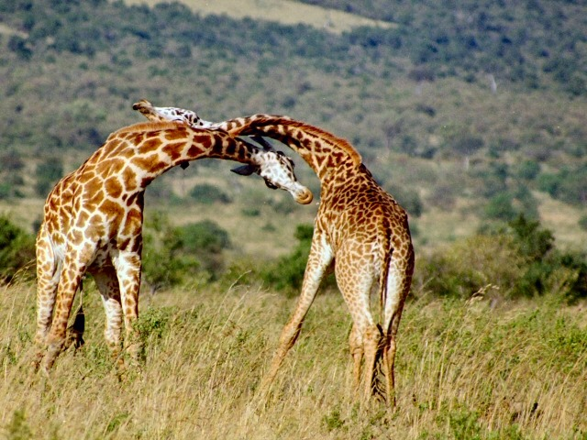
Sexual Selection
Selection based on how attractive an organism is to potential mates…
Example: Why do giraffes have long necks?
Eating?
Fighting!

Slide 10
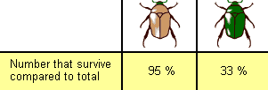
Fitness (Survival of the Fittest)
The brown beetles have a greater fitness relative to the green beetles.
NOT pumping iron! NOT staying in shape
The organism that is best suited to its current environment will live AND pass on its genes
Example:

Slide 11
Mechanisms for Evolution
Do populations or individuals evolve?
What is a gene pool
How can the gene pool change?
Mutation
Genetic drift
Gene flow (migration)
Would these things effect a large population or a small population more?
Life Sciences-HHMI Outreach. Copyright 2006 President and Fellows of Harvard College.

Slide 12
Mutation
Mutation is a change in DNA. A change in an organism’s DNA can cause changes in all aspects of its life.
Mutations are random. Mutations can be beneficial, neutral, or harmful for the organism, but mutations do not “try” to supply what the organism “needs.”

Slide 13
Genetic Drift
By chance, individuals leave behind more descendents (and genes)than other individuals.
The genes of the next generation will be the genes of the “lucky” individuals, not necessarily the healthier or “better” individuals.

Slide 14
Gene Flow (Migration)
Any movement of genes from one population to another.
Example: Pollen being blown to a new destination, People moving to new cities or countries
If genes are carried to a population where those genes previously did not exist, gene flow can be a very important source of genetic variation.

Slide 15
WHAT IS SPECIATION?
GEOGRAPHIC ISOLATION
REPRODUCTIVE ISOLATION
http://evolution.berkeley.edu/evolibrary/home.php
Life Sciences-HHMI Outreach. Copyright 2006 President and Fellows of Harvard College.

Slide 16
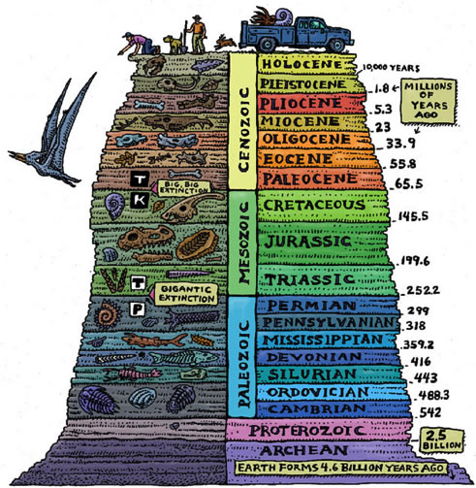
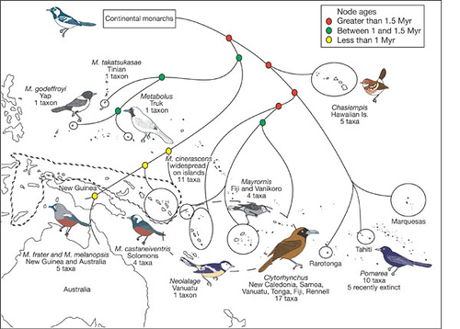
Evidence for Evolution:
Paleontology- fossil record shows change over time
Biogeography- similar species live near each other

Slide 17
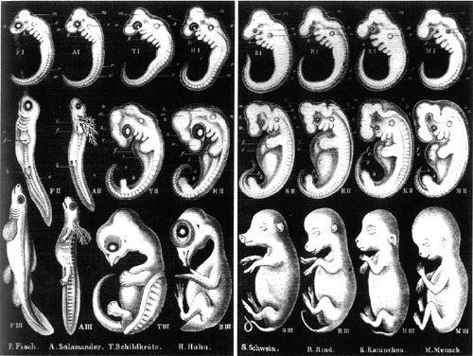
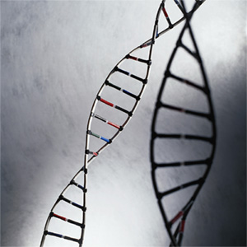
Evidence for Evolution:
Embryology- an embryo displays its ancestral past as it develops
Genetics- similar species have more similar genes in common. We can see relation through DNA

Slide 18
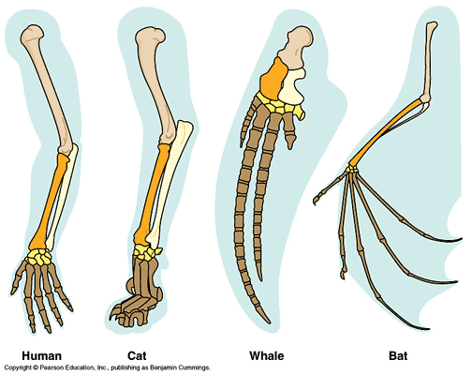
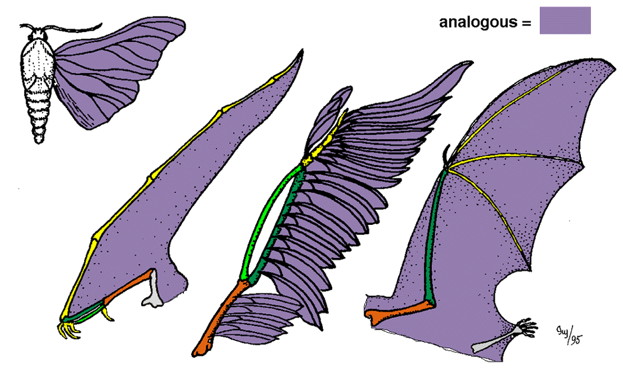
Evidence for Evolution:
Morphology- (shape) shows species adapt ancestral structures for new uses
Homologous structures-from the SAME ancestral structure
Analagous structures- adapted for the same purpose but not from the same ancestral structure (ex.- wings on moth, bird, bat, pterodactyl

Slide 19
Steps to Evolution

Slide 20
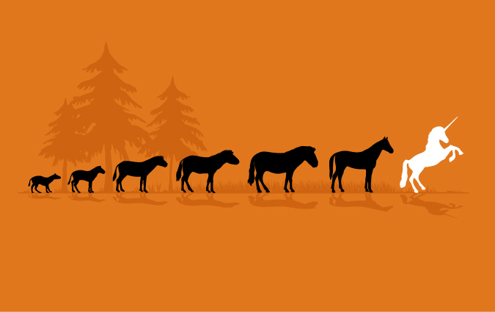
Evolutionary Lineage of the Horse

Slide 21
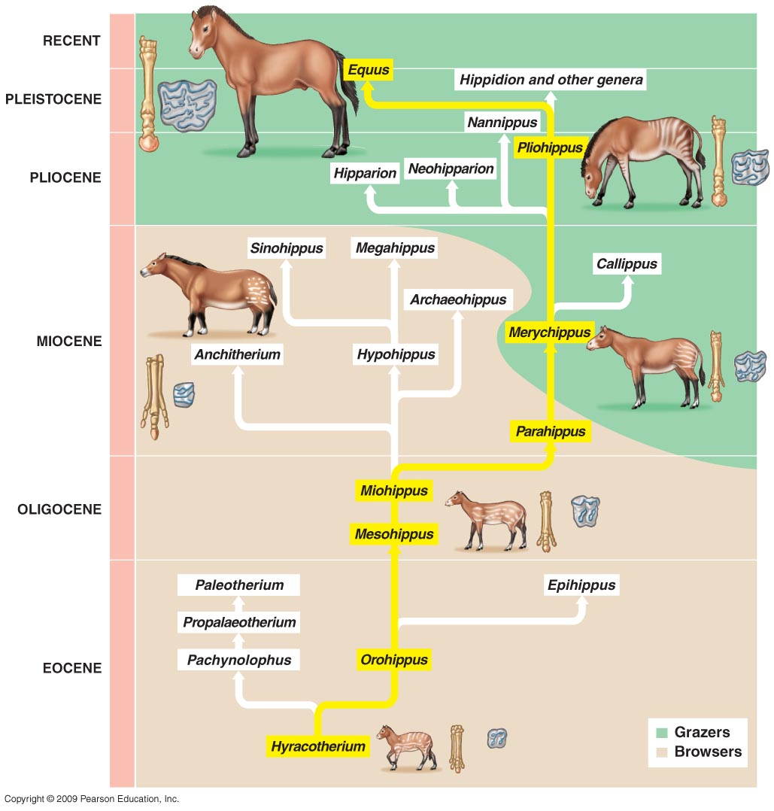

Slide 22
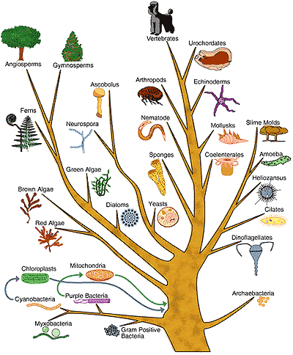

Slide 23
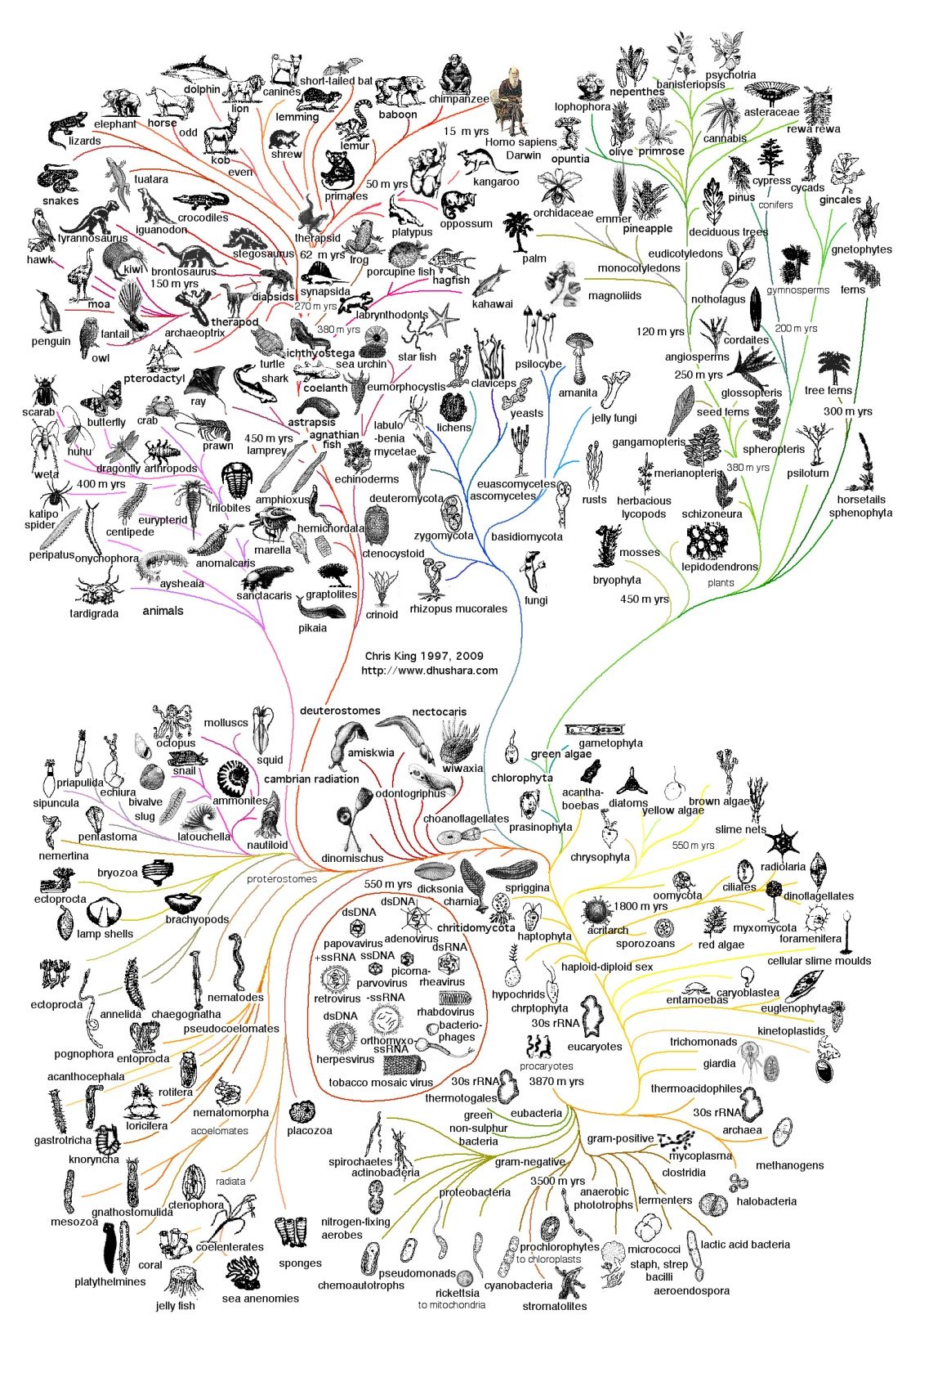

Slide 24
