Slide 1
Karyotype
Photograph of the complete set of chromosomes for an individual

Slide 2
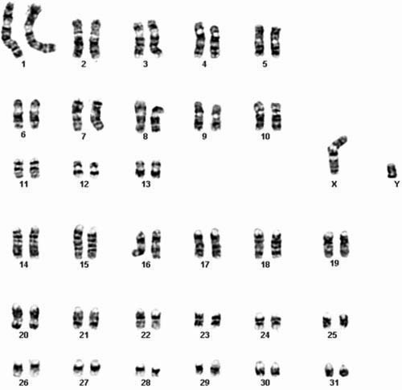
Human Horse
22 Autosome pairs: 1 sex chromosome pair
46 Chromosomes Total
30 autosome pairs: 1 sex chromosome pair

Slide 3
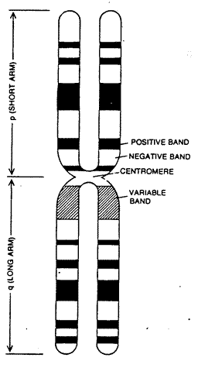
Arrangement Criteria
Chromosomes are arranged and matched by 3 criteria
1. Size
Longer chromosomes are numbered lower (Chromosome 1 is the longest)
2. Banding Pattern
Each chromosome bas a distinct pattern of bands on it that only matches its pair
3. Location of centromere
Metacentric: middle
Acrocentric: near one end
Sub metacentric: in between middle and end

Slide 4
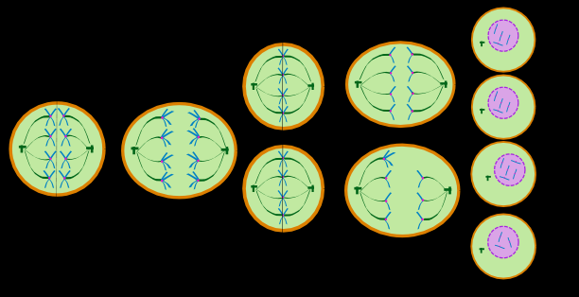
Abnormal Karyotypes: when meiosis goes wrong
Caused by meiotic non-disjunction: Failure of chromosomes to separate during meiosis.
One of the resulting cells will have an extra copy of the chromosome and another will have no copy.

Slide 5
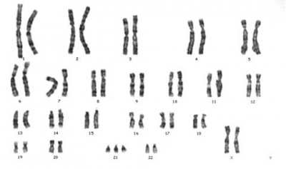
When meiosis goes wrong…..
Aneuploidy: Abnormal amount of chromosomes in an individual
Too many: Polyploidy (Trisomy, Tetrasomy etc).
Only one: Monosomy

Slide 6
Vocabulary Preview
Cytogenetics
Karyotype
Amniocentesis
Gestation
Hereditary
Prognosis
With your table group come up with a definition for each of the words: If you do not know the definition, give it your best guess based on what you do know and what we have talked about so far today

