Slide 1
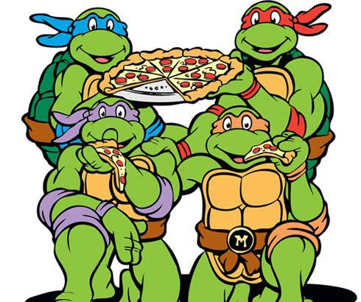
Mutations in the Genetic code
Dun dun dun!!!!!

Slide 2
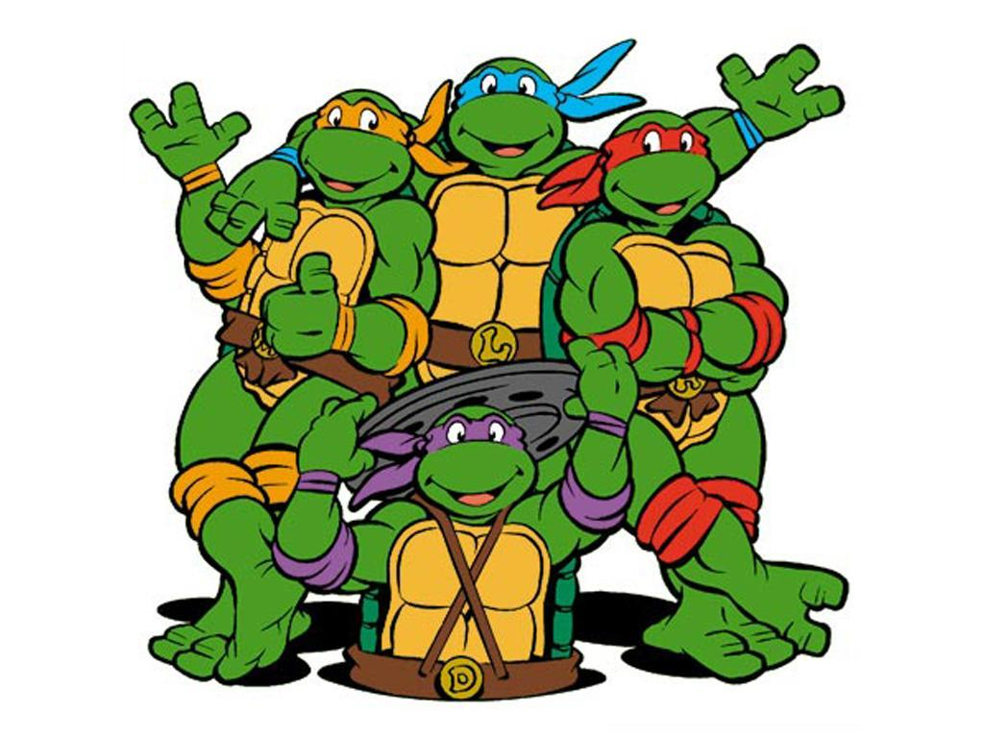
Nobody’s perfect all the time
About 1/10 billion base pairs end up with a error or mutation
Mutation: Mistake in replication or environmental effect that results in a change to the nitrogenous bases in DNA or RNA.
Substitution (not as bad)
Frame Shift Mutations (can be very bad)

Slide 3
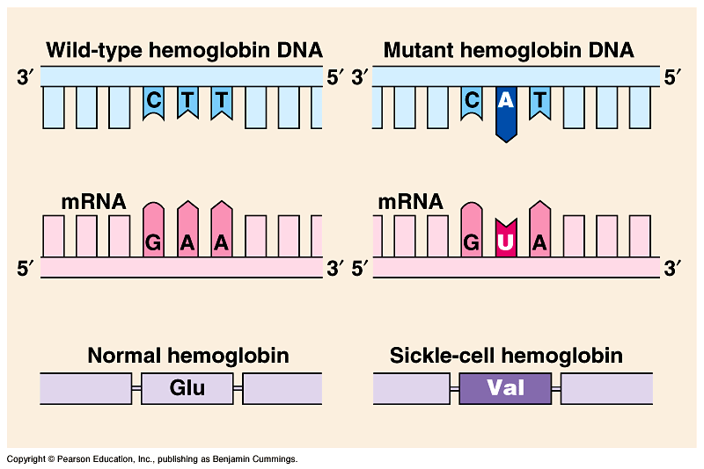
Substitution Mutations
Substitution Mutations:
Pairing the wrong bases together
Single base paring/order effected
3 types
Silent
Missense
Nonsense

Slide 4
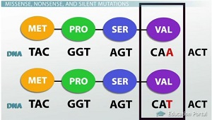
Silent Mutations: Mutation does not effect amino acid that is coded for. The Genetic Code has some redundancy in it which allows for minor mistakes without effecting proteins.
Silent Mutations: No effect seen from the change

Slide 5
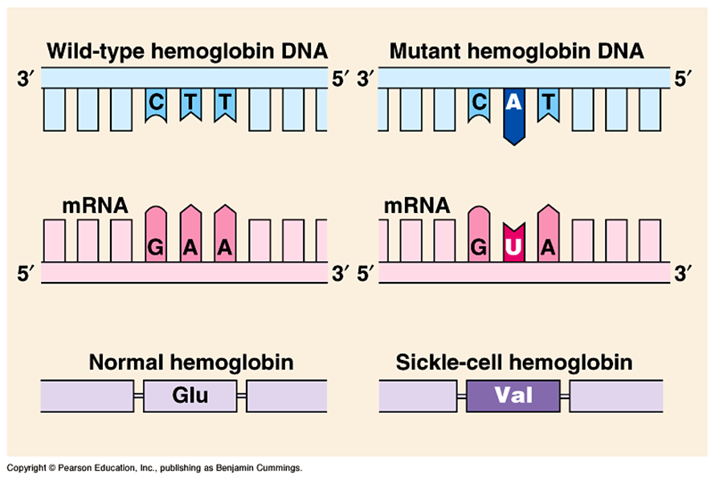
Missense Mutation
Missense Mutation
Changes the sequence to code for one wrong amino acid
Only one amino acid effected

Slide 6
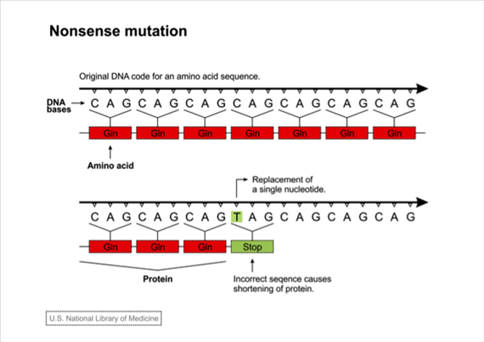
Nonsense Mutation
Nonsense Mutation
Changes the code to a premature stop codon
So only part of the protein is coded for
Protein unlikely to be able to perform function

Slide 7
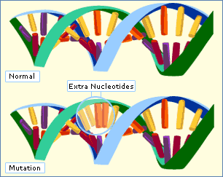
Frame Shift Mutations: Shifts the codon sequence
Insertion Mutation
Extra Base Pair is added to the sequence
Deletion Mutation
Base Pair is not included

Slide 8
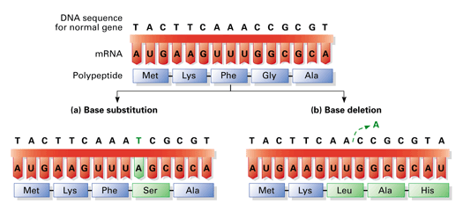
Why is a frame shift worse for the organism?
Frame Shift Mutations can change the amino acid order for the rest of the polypeptide chain.
Frame shift mutations can be catastrophic for the organism.
Frame Shift Mutations rarely code for functional protein

Slide 9
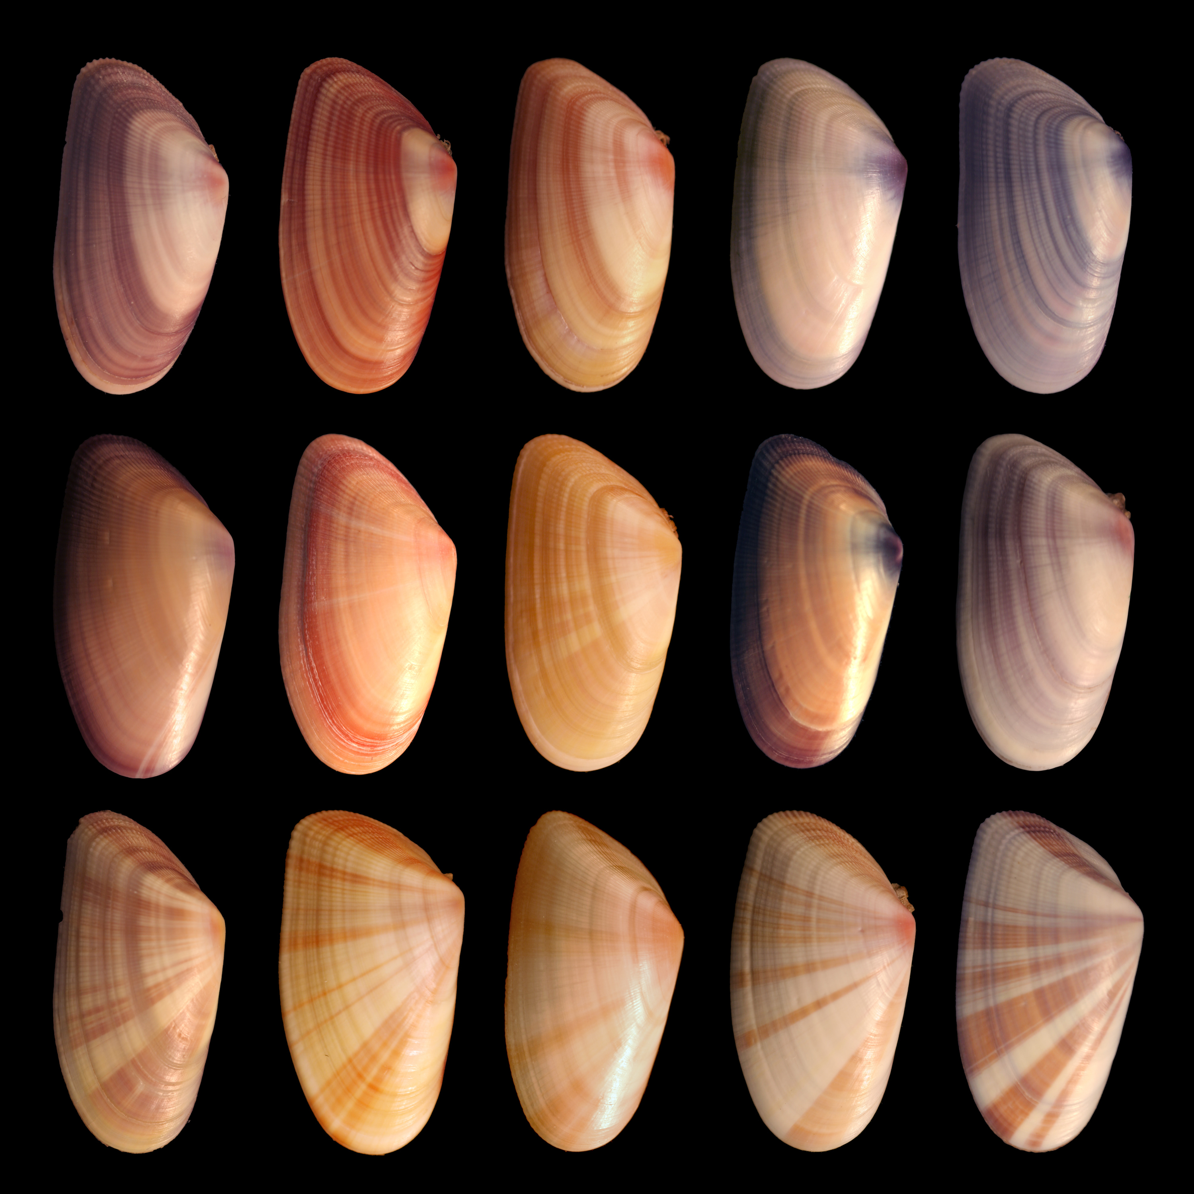
Are mutations always bad?
Mutations lead to variation in the genome, allowing for natural selection to increase offspring chances for survival.
Genome: Sum total of all genetic material in an organism
Most mutations have negative effects, changing the protein so it does not function
Some mutations can have beneficial effects for the organism – over time this can help the species survive as a whole

Slide 10
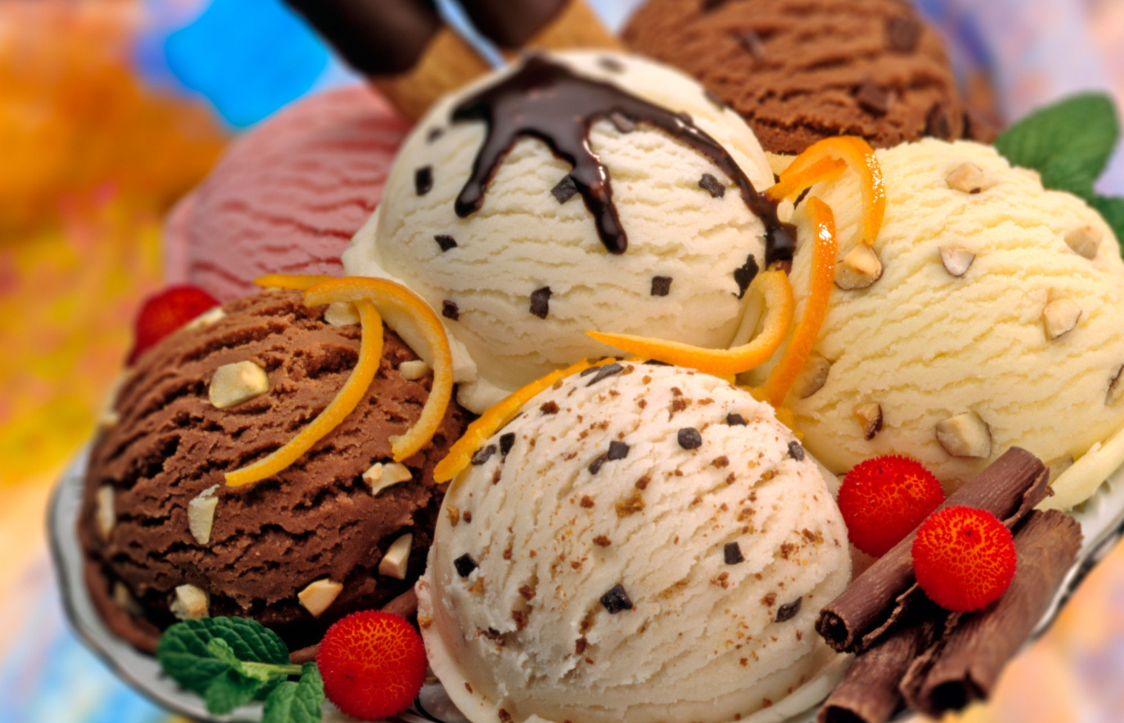
Beneficial Mutation Example: Lactase Persistence in Humans
Mammals usually lose the ability to break down lactose (milk) shortly after babyhood
We can eat ice cream because of a mutation that some humans continue to make the protein lactase (an enzyme that breaks down lactose)

