Slide 1
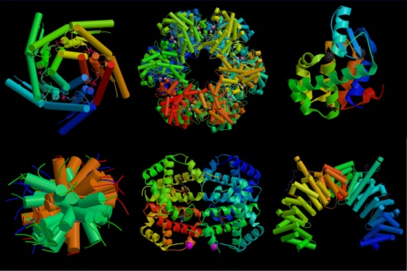
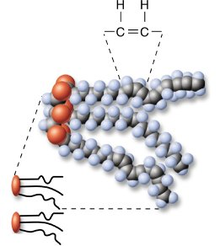
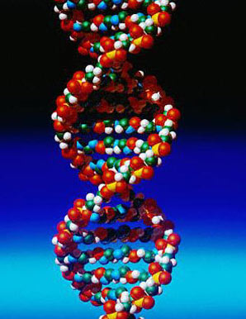
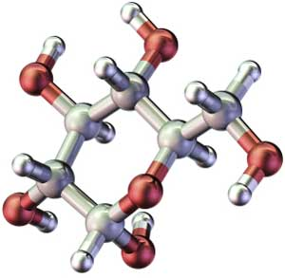
Organic Chemistry: “Chemistry of Life”
General Biology
Glencoe High School
2010-11

Slide 2
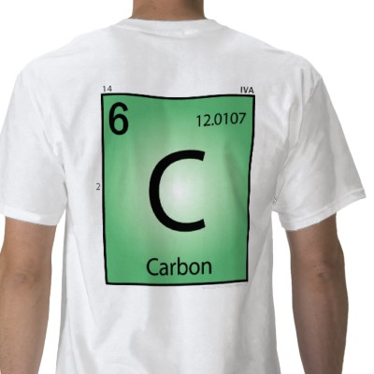
Organic molecules:
Compounds containing the element carbon (C)
Usually associated with living things
Other elements commonly found in organic molecules:
Hydrogen (H)
Oxygen (O)
Nitrogen (N)
Phosphorus (P)
Sulfur (S)

Slide 3
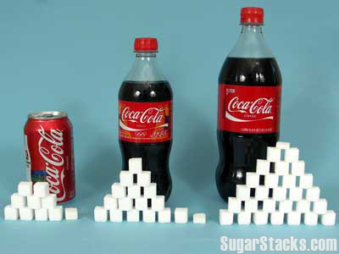
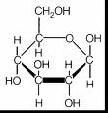
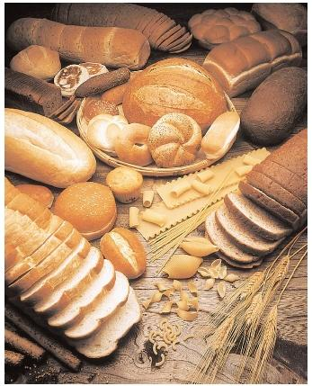
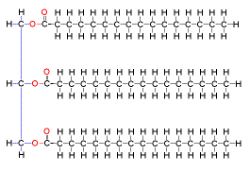
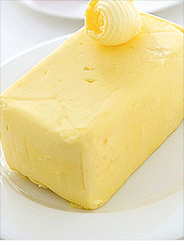
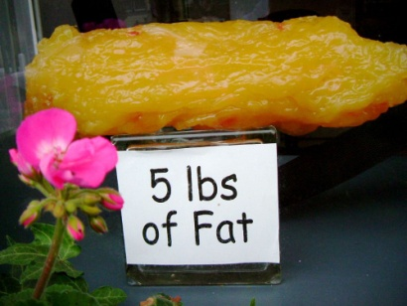
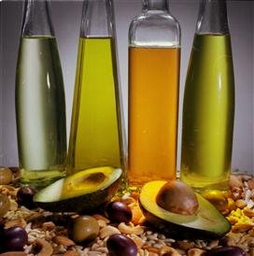
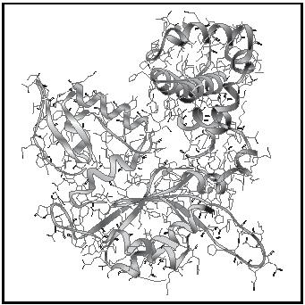
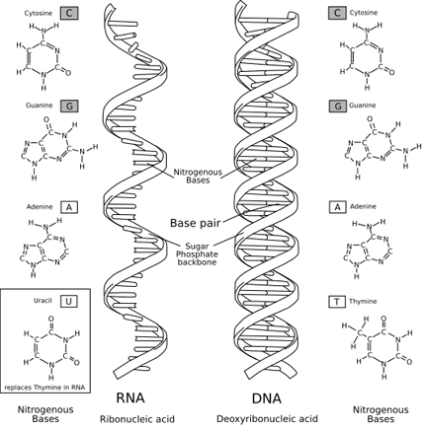
4 main groups of organic molecules:
1. Carbohydrates →
2. Lipids →
3. Proteins →
4. Nucleic Acids →

Slide 4
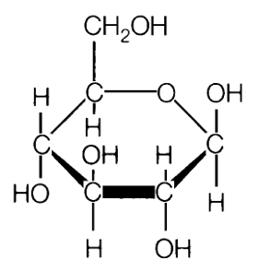
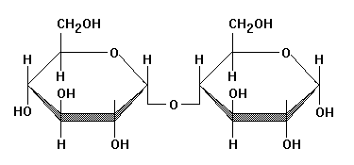
“Macromolecules”:
Organic molecules are most often considered “macromolecules” (macro = large)
They are made of “building block” molecules called monomers.
2 monomers can combine to form a dimer (di= two), and many monomers combine to form a polymer (poly= many)
monomer
dimer
polymer

Slide 5
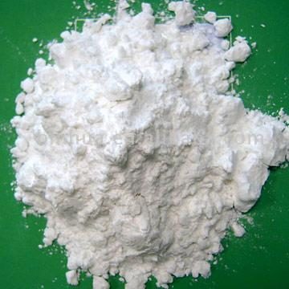
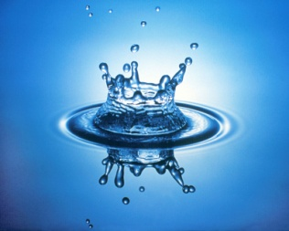
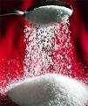
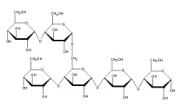
Monomers join together in a reaction called “dehydration synthesis”. (dehydration = water loss) (synthesize = combine)
-Large molecules formed = water is lost
See animation: http://nhscience.lonestar.edu/biol/dehydrat/dehydrat.html
H₂O
H₂O
The opposite of dehydration synthesis is called “hydrolysis” (requires water)

Slide 6
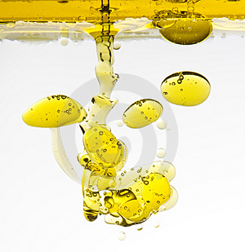
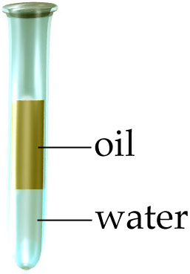
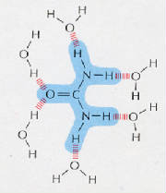
Some organic molecules, like lipids, are said to be hydrophobic
-they will not mix with water
Other organic molecules are hydrophilic
-they mix well with water

Slide 7
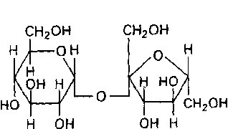
Carbohydrates:
-Made of ONLY Carbon, Hydrogen, and Oxygen
1. Sugars -
-Monosaccharides= “single sugars” (ex.- glucose)
-Disaccharides= “double sugars” (ex.- sucrose, table sugar)
-for FAST energy

Slide 8
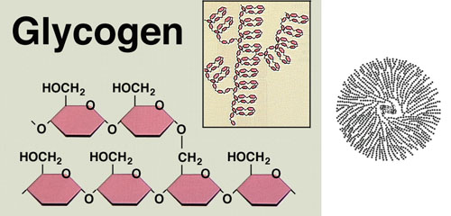
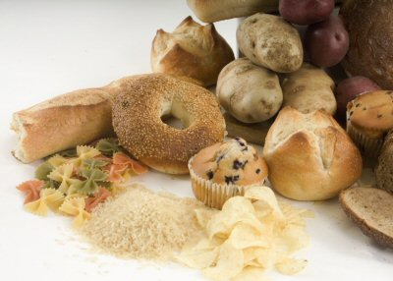
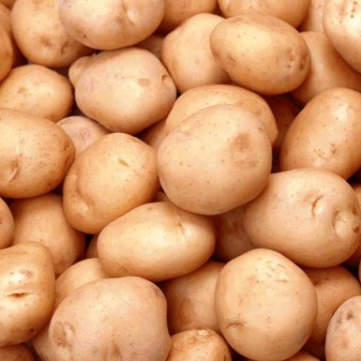
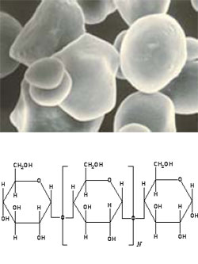
2. Starch (plants) and Glycogen (animals)-
-Polysaccharides= “many sugars”
-Stored Energy (broken down into sugars later)
Glycogen is stored in the liver
Starch is stored in seeds, grains and tubers

Slide 9
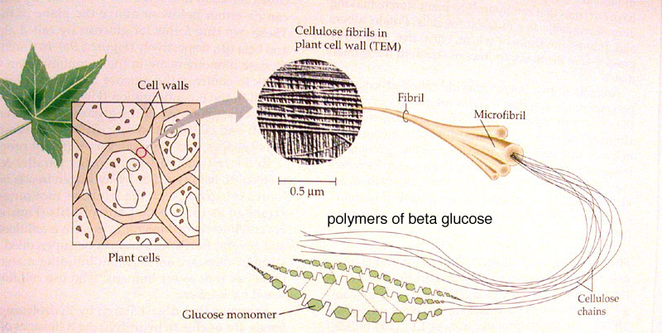
3. Cellulose-
-Found ONLY in plants
-Structural molecule (makes plants rigid)
-Indigestible by animals (“fiber”)

Slide 10
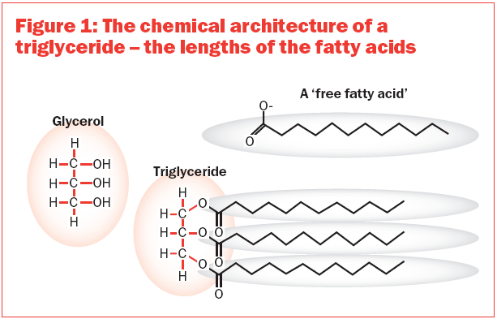
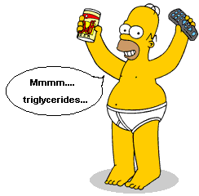
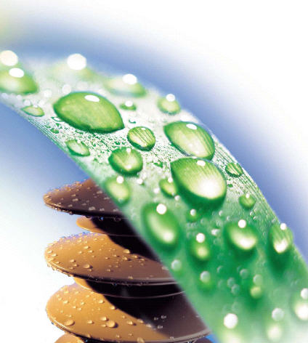
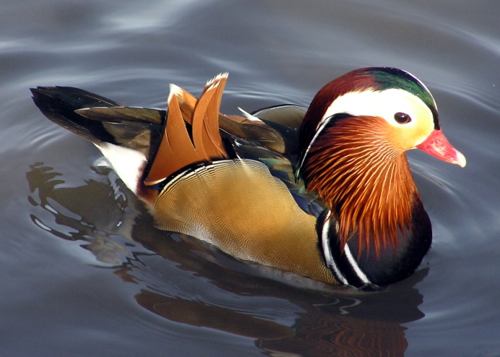
Lipids: Made of ONLY Carbon, Hydrogen, and Oxygen
1.Fats and Oils
-LONG TERM energy storage
-Made of 1 glycerol molecule & 3 fatty acids (Triglycerides)
2. Waxes
-water repellent

Slide 11
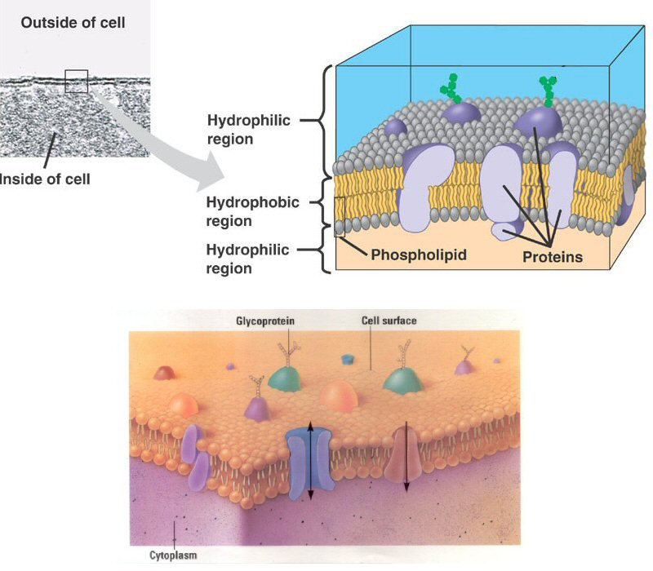
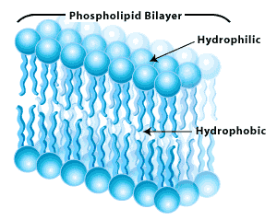
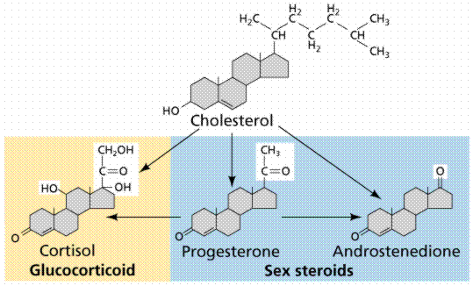
3. Phospholipids
-cell membranes
-hydrophilic heads
-hydrophobic “tails”
4. Steroid hormones
-chemical control of some body functions
-made from cholesterol

Slide 12
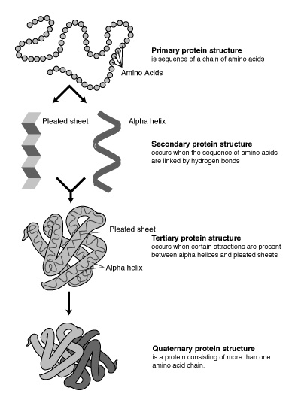
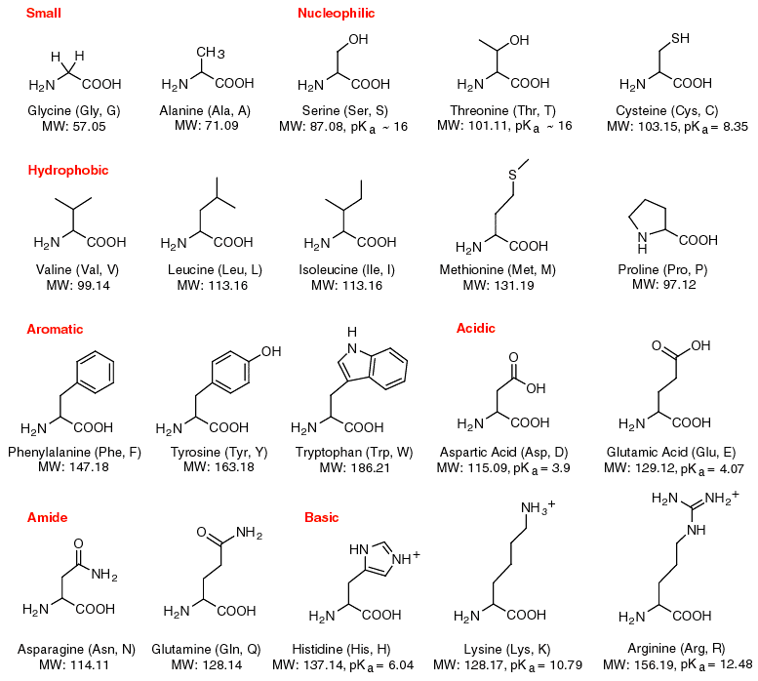
Proteins:Made of Carbon, Hydrogen, Nitrogen and Oxygen
-over half the dry weight of your body
-VERY LARGE with complex 3-dimensional structures
-made of combinations of 20 different amino acids

Slide 13
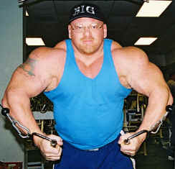
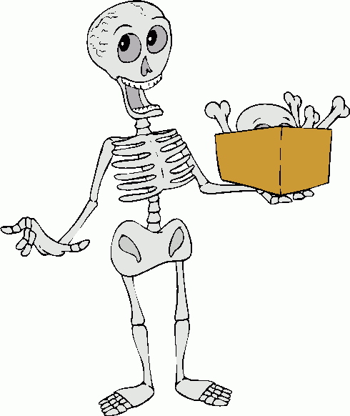
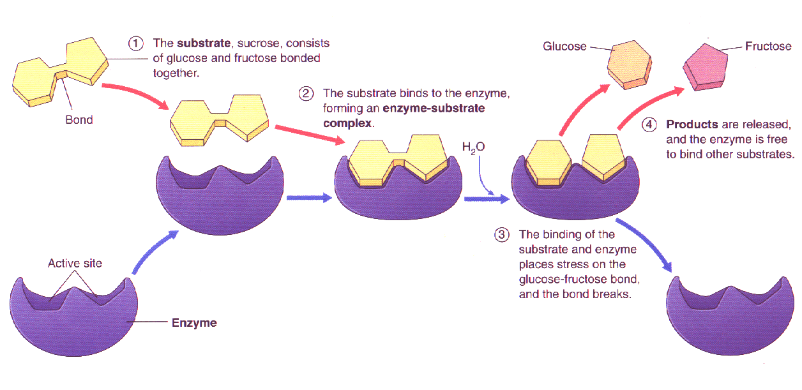
- proteins perform MANY functions:
Movement (muscles)
Structure (bones)
Chemical Regulation (enzymes speed up chemical reactions)

Slide 14
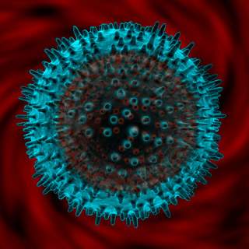
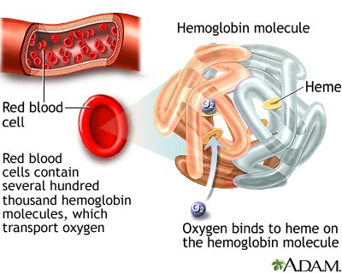
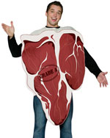
Defense (antibodies of the immune system)
Transport (hemoglobin in red blood cells)
Nutrition

Slide 15
Enzymes speed up reactions at normal temperatures

Slide 16
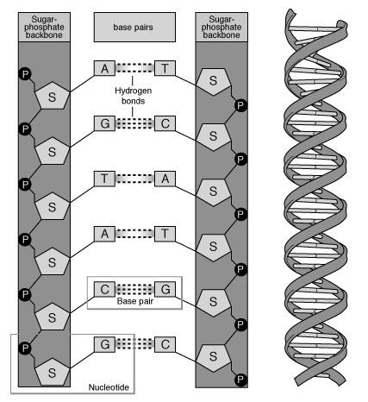
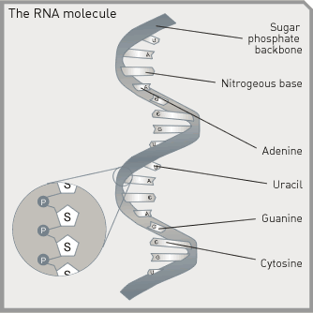
-
Made of Carbon, Hydrogen, Nitrogen, Phosophorus and Oxygen
Consist of repeating units called nucleotides
Nucleic Acids:
1. DNA- forms the genetic code (codes for proteins)
2. RNA- vital part of protein building process

Slide 17
Organic Molecules:
4 classes
Nucleic Acids
Proteins
Lipids
Carbo- hydrates
also known as

