Slide 1
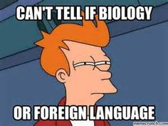
Monday April 18th, 2016
Agenda:
1. Blue Whale Daily Starter
2. Notes- Population Genetics
3. Allele Frequency WS
Focus Question: What are the conditions for a non-changing population?

Slide 2
Population Genetics
Study of Genetic Variation in whole populations
Population: All Organisms in a geographic area that are the same species and capable of interbreeding.
Genetic Variation
How allele frequency changes over time
Exchange of genetic Material

Slide 3
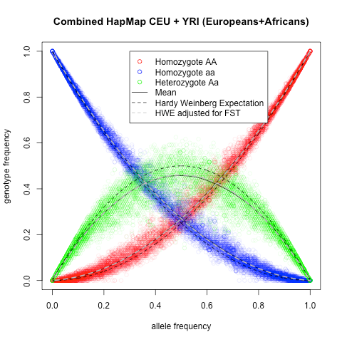
Allele Frequency how often that allele form appears in a population (as a decimal)
.5 = 50% etc…
Reminder!
Allele is a form of a gene
Each individual has 2 alleles for each gene so…
# of individuals = # of total alleles
2

Slide 4
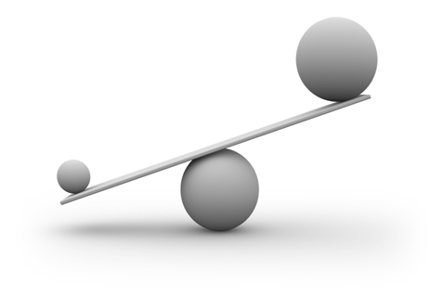
Hardy-Weinberg equilibrium Allele Frequency in non-changing populations
Five conditions
1. Large population size
2. random mating
3. no mutation
4. no migration (in or out of the population)
5. no natural selection
When a population is not evolving the allele frequencies are not changing= genetic equilibrium.

Slide 5
p + q = 1
Remember: allele frequency (how much you see that form of the gene in a population) is a decimal
P = frequency of the dominant allele
Q = Frequency of the recessive allele
In kermitfrogs the frequency of the dominant allele for being green is 84%. What is the frequency of the recessive allele?

Slide 6
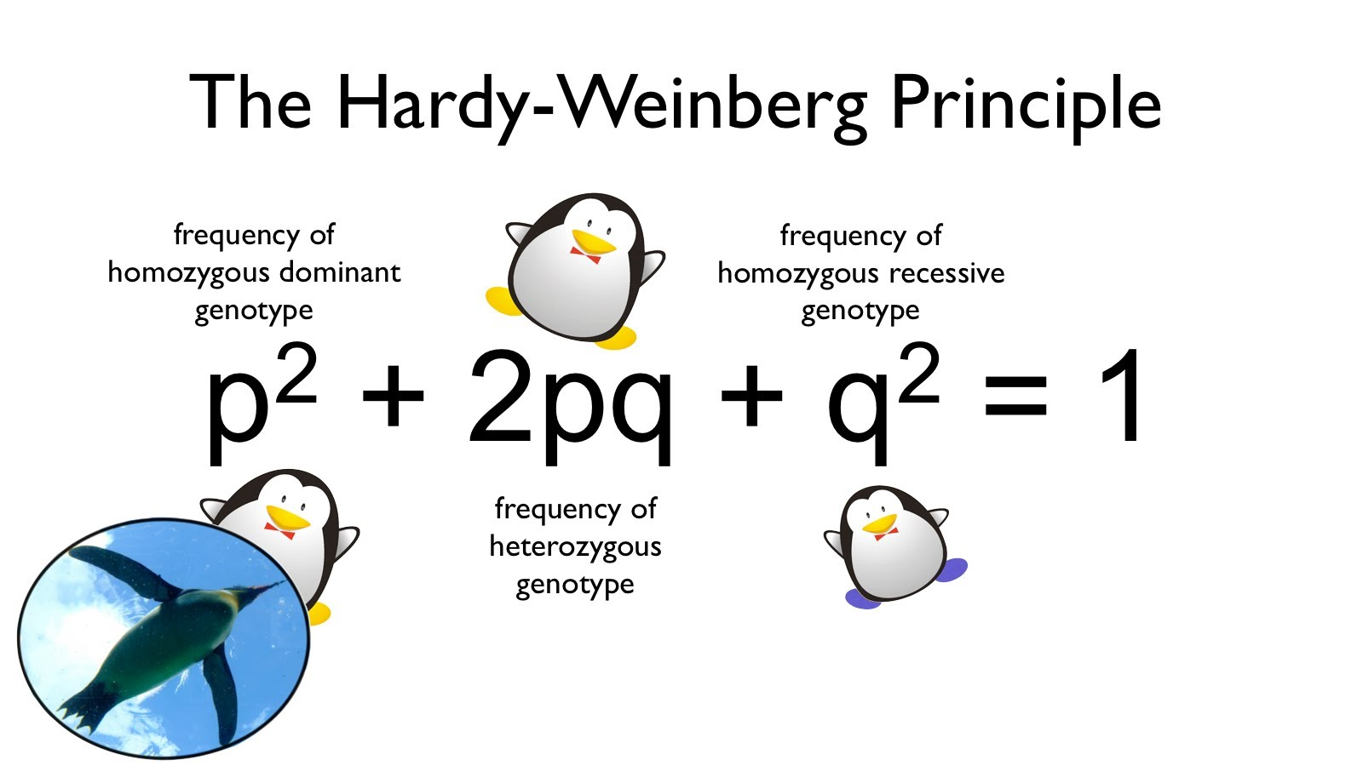
P² + 2pq + q² = 1
This equation tells you the frequency of genotypes in the population
P² = Homozygous dominant genotype
2pq = heterozygous genotype
Q² = homozygous recessive genotype
* P² or 2PQ =Dominant Phenotype
* Q² = Recessive phenotype

Slide 7
Examples- yes, you should have these in your notes ☺
A population of rabbits may be brown or white (the recessive phenotype). Brown rabbits have the genotype BB or heterozygous. White rabbits are homozygous recessive. The frequency of the homozygous recessive genotype is .35.
What is the frequency of the recessive allele?
What is the frequency of the dominant allele?
What is the frequency of heterozygous rabbits?

Slide 8
Moths Example
In a population of peppered moths, 30% of the population shows the recessive phenotype of white.
Which of the variables does 30% represent?
Given this information, what is the frequency of recessive alleles in the population (q)?
What is the value of p? How do you know?
If this population had 1000 moths. How many moths would be Homozygous dominant? Heterozygous? Homozygous recessive?

Slide 9
Rh protein example
In the US, 27% of the population has Rh negative blood, which is recessive. If the student population of glencoe High School was 2,000, how many students would you expect for each of the three possible genotypes? Find q first.

Slide 10
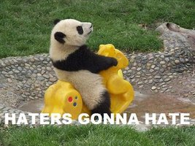
Friday April 22, 2016
Agenda:
1. Panda Bear Daily Starter
2. Notes: Genetic Change
3. Population Genetics Simulation
In table group, come up with 5 things you know about Panda Bears – anything you know counts
Focus Question: How does population size effect a species chances for survival?

Slide 11
Evolution: Change of allele frequency in a population over time
Studying how allele frequencies change in a population over time= studying how the population is evolving
Non- hardy Weinberg : 5 causes of evolution *Begins by change in allele frequency*
1. Small populations
2. non-random mating
3. mutation occurs
4. migration (new genes in or loss of genetic diversity)
5. natural selection acts on population

Slide 12
1. Small population size = genetic drift
Genetic drift: Elimination or drastic change in allele frequencies due to small population size
Random events that eliminate genes from a population
**Loss of genetic diversity**
**occurs in smaller populations**

Slide 13
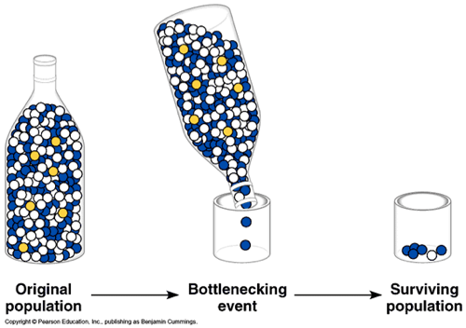
Bottleneck Effect
When a populations size is dramatically reduced for at least one full generation
leaving small population of survivors chosen by chance, NOT genetic fitness to survive
Examples:
Humans Caused: Blue Whale
Natural: Earthquake, Tsunami etc….

Slide 14
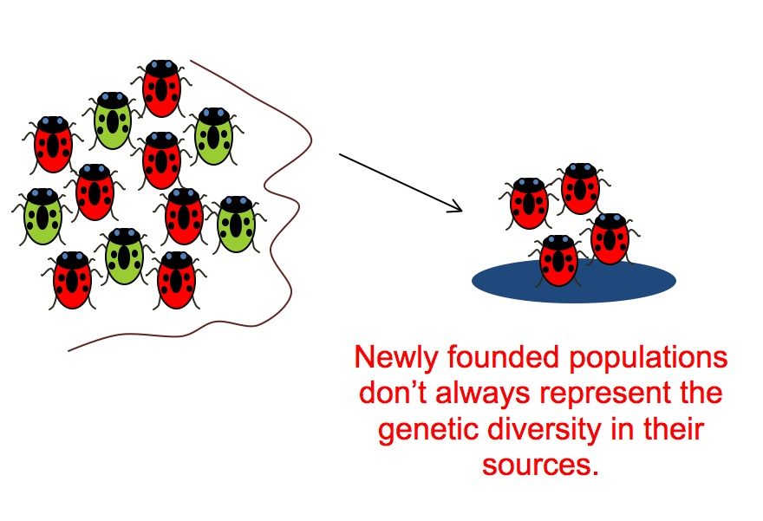
Founder Effect
Reduced genetic diversity when a small group separates from larger population
Instant geographic separation vs. bottleneck lasts as long as what is killing off population
Example: Dutch settlers in South Africa have higher instance of Huntington's because original settling population had high occurrence.

Slide 15
Speciation
Loss of Genetic diversity can lead to speciation
Speciation is the evolutionary process by which reproductively isolated biological populations evolve to become distinct species.

Slide 16
Allopatric Speciation

Slide 17
Sympatric speciation

Slide 18
2. non-random mating
Sexual selection

Slide 19
3. Mutations occurs: Importance of genetic diversity for populations survival

Slide 20
4. Migration occurs
Gene flow

Slide 21
5. Natural selection occurs
Darwin

