Slide 1
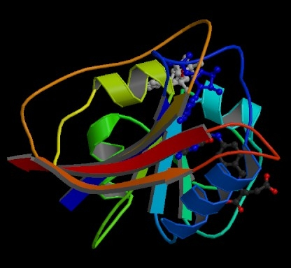
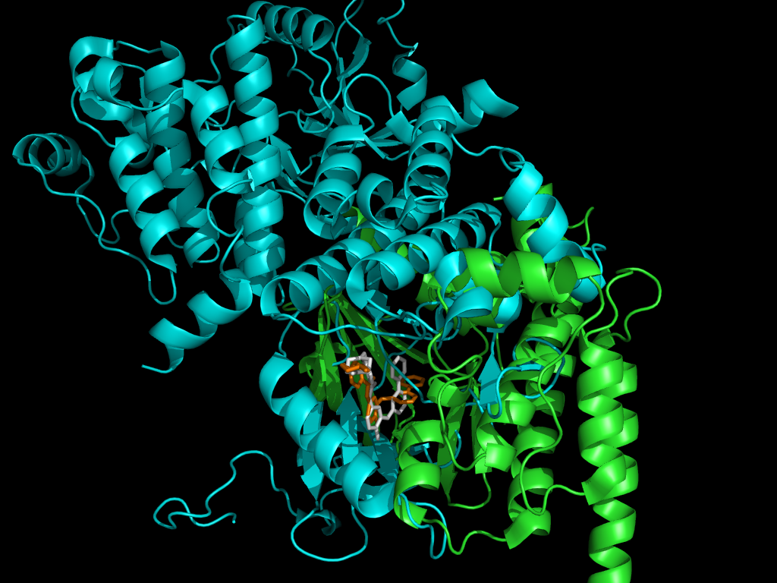
Protein Synthesis
It’s All About Proteins
Proteins make the world go round

Slide 3
STRUCTURE OF DNA
Consists of two strands of nucleotides that form a twisted ladder (double helix)
Sugar and phosphate alternate along the sides of the ladder (linked by strong covalent bonds)
Pairs of nitrogen bases form the rungs of the ladder (linked by weak hydrogen bonds).

Slide 4
FUNCTION OF DNA
Genes (sections of DNA) code for proteins (structural proteins, enzymes, and hormones)
info for building proteins is in the sequence of nitrogen bases
proteins determine physical and metabolic traits and regulate growth and development.

Slide 5
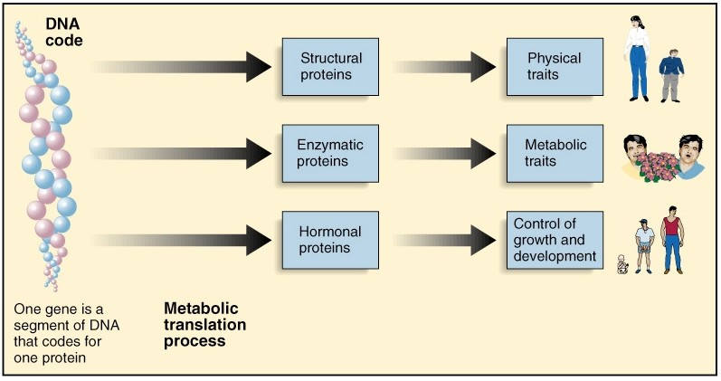

Slide 6
RNA (RIBONUCLEIC ACID)
Nucleic acid involved in the synthesis (building) of proteins
Composed of nucleotides, but differs from DNA in three ways.
Single strand of nucleotides instead of double stranded
Has uracil instead of thymine
Contains ribose instead of deoxyribose

Slide 7
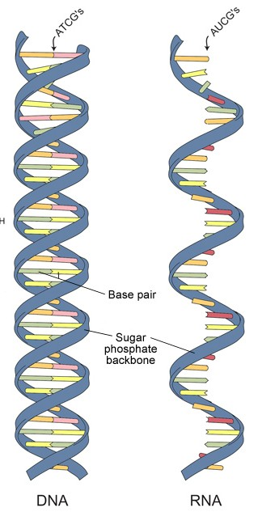
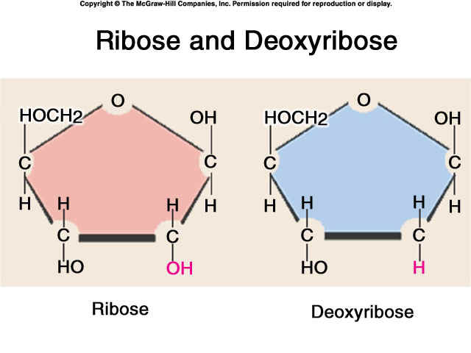

Slide 8
RNA FUNCTION
Three forms of RNA involved in protein synthesis
mRNA (messenger): copies instructions in DNA and carries these to the ribosome.
tRNA (transfer): carries amino acids to the ribosome.
rRNA (ribosomal): what the ribosome is made of.

Slide 9
PROTEIN SYNTHESIS
Cells build proteins following instructions coded in DNA.
Consists of two parts:
Transcription
Translation

Slide 10
TRANSCRIPTION
DNA is copied into a complementary strand of mRNA.
WHY?
DNA cannot leave the nucleus. Proteins are made in the cytoplasm. mRNA serves as a “messenger” and carries the protein building instructions from the DNA in the nucleus to the ribosomes in the cytoplasm.

Slide 11
HOW TRANSCRIPTION OCCURS
RNA polymerase untwists and unzips a section of DNA
RNA polymerase pairs free RNA nucleotides to the exposed bases
Uracil instead of thymine!
Only 1 strand of DNA serves as a template, the other “hangs out”
The new mRNA separates from template DNA and DNA zips back up.

Slide 12
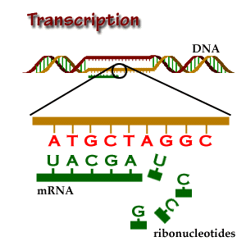
RESULT OF TRANSCRIPTION:
An mRNA strand leaves the nucleus and goes to a ribosome.

Slide 13
TRANSCRIPTION EXAMPLE
Let’s transcribe the following DNA Sequence in mRNA
TAC CGG ATC CTA GGA TCA
AUG GCC UAG GAU CCU AGU
Now you try it with your neighbor
AGA CCT GCT GCT GGA TCA
UCU GGA CGA CGA CCU AGU

Slide 14
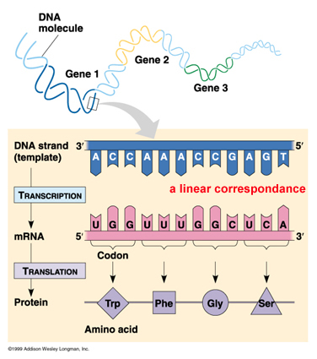

Slide 15
GENETIC CODE
The “language” that translates the sequence of nitrogen bases in DNA (mRNA) into the amino acids of a protein.
Codon = three nucleotides on DNA or mRNA
Example: GCT or UAG
One codon = one amino acid
Multiple codons may code for the same amino acid
Amino acids join to make a protein
The genetic code is universal to all organisms

Slide 16
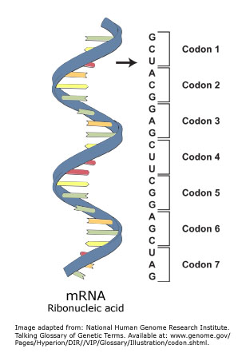

Slide 17
DNA: TAC CTT GTG CAT GGG ATC
mRNA AUG GAA CAC GUA CCC UAG
Amino acid MET G.A HIS VAL PRO STOP

Slide 18
TRANSLATION
Instructions in mRNA are used to build a protein
Occurs on ribosome (in the cytoplasm)

Slide 19
PROCESS OF TRANSLATION
1. mRNA binds to the ribosome.
2. Ribosome searches for start codon (AUG)
3. tRNA brings correct amino acid (methionine) to the ribosome.
Each tRNA carries one type of amino acid.
The anticodon (three nitrogen bases on tRNA) must complement codon for amino acid to be added to protein chain

Slide 20
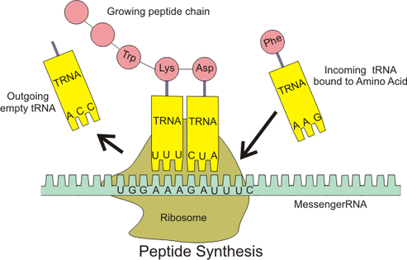
Another Good Picture

Slide 21
PROCESS OF TRANSLATION
4. ribosome reads next codon
5. tRNA’s continue lining up amino acids according to codons
6. peptide bonds link amino acids together
7. ribosome reaches STOP codon
Amino acid chain is released

Slide 22
Another Good Picture

Slide 23
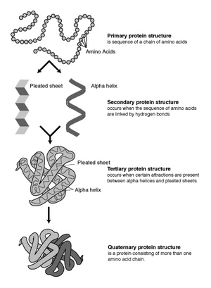
RESULT OF TRANSLATION
A Protein!

Slide 24
PROTEINS
Structural and functional components of organisms.
Composed of amino acids
order of nucleotides in DNA determines order of amino acids in a protein
One gene codes for one protein

Slide 25
Protein Synthesis Animation
Transcription: http://www.dnalc.org/resources/3d/12-transcription-basic.html
Tranlsation: http://www.dnalc.org/resources/3d/TranslationBasic_withFX0.html

