Slide 1
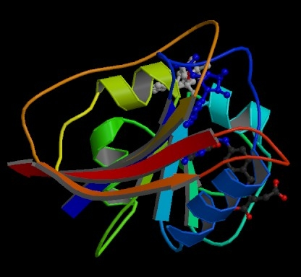
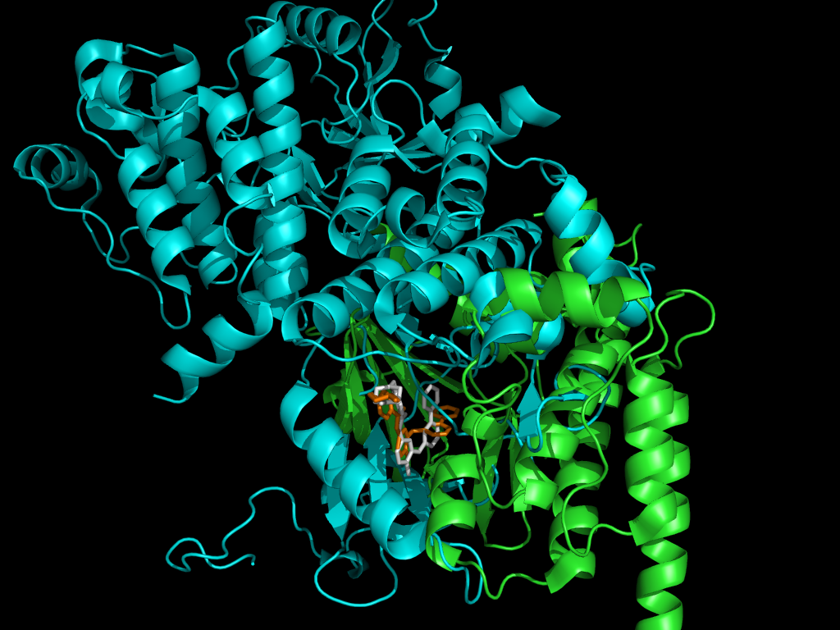
Protein Synthesis
It’s All About Proteins
Proteins make the world go round

Slide 2
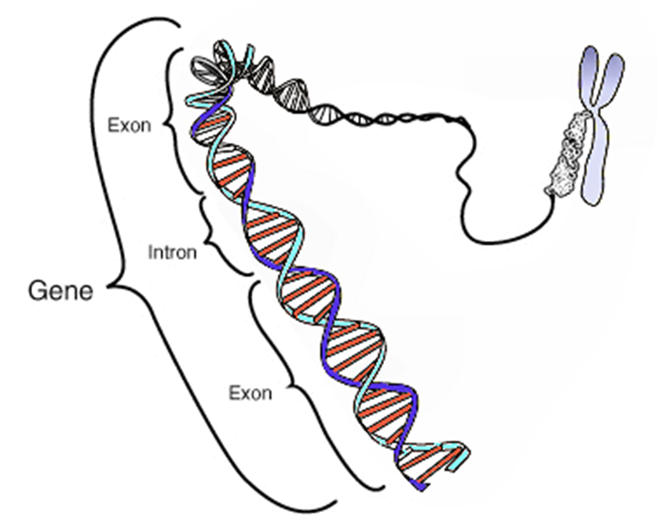
Central Dogma: From DNA to Protein
Gene: Sequence of nucleotides (A, T, C, G) whose order determines the amino acids used to build proteins or other molecules the organism needs to function.
What is the relationship between DNA, chromosomes and Genes?

Slide 3
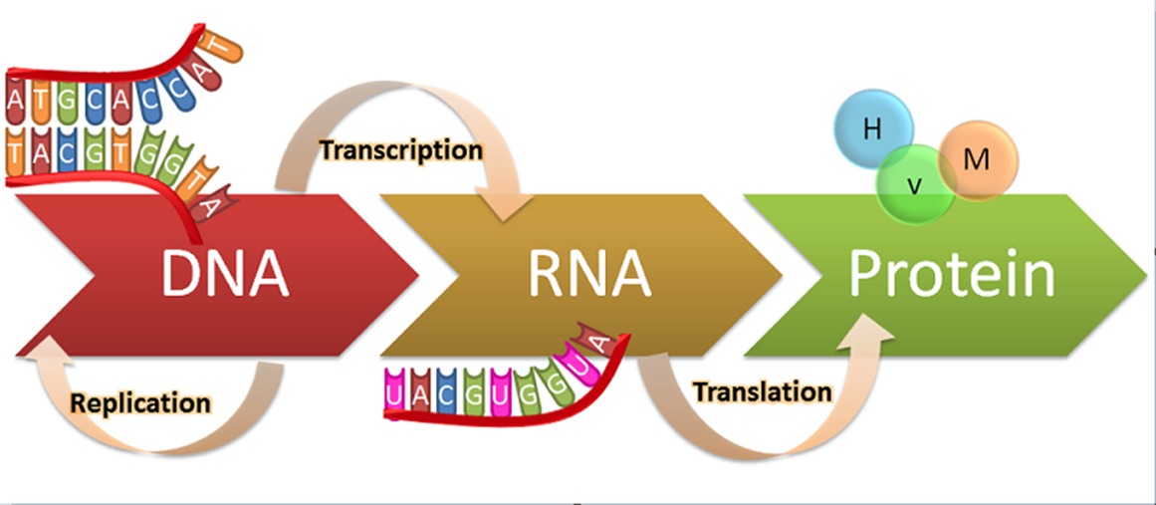
Central Dogma
Central Dogma is the pathway for how genetic information stored in DNA becomes proteins
Goes from DNA to RNA to Proteins
Proteins determine our traits, growth and development and metabolic needs.

Slide 4
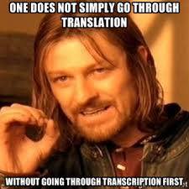
Central Dogma cont….
WHY do we need the RNA middle man?
DNA cannot leave the nucleus. Proteins are made in the cytoplasm. So how do we get from our instructions to the ribosome to build proteins?
mRNA!!!!!
serves as a “messenger” and carries the protein building instructions from the DNA in the nucleus to the ribosomes in the cytoplasm.

Slide 5
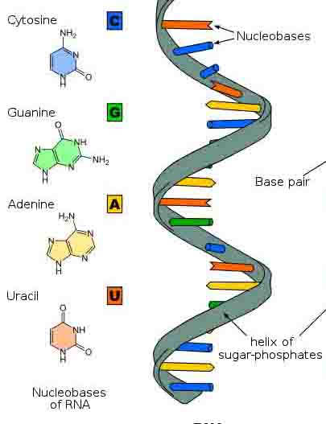
RNA Structure: Similar to DNA
RNA vs DNA
Single Stranded | Double Stranded
Uracil | Thymine
Ribose Sugar | Deoxyribose Sugar
RNA is a nucleic acid involved in the synthesis (building) of proteins

Slide 6
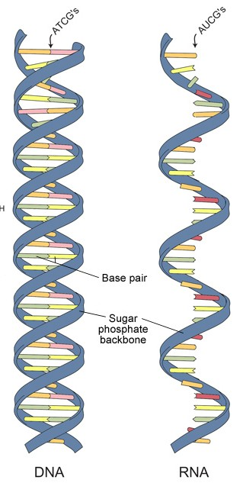
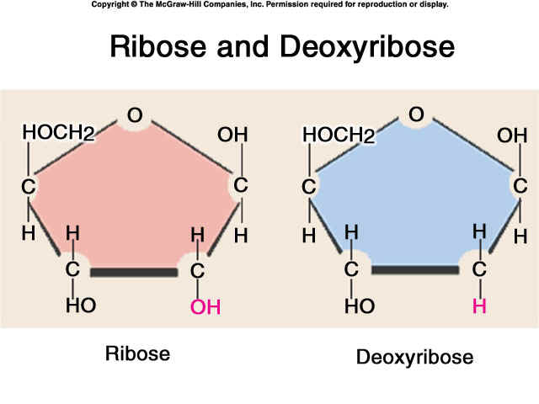

Slide 7
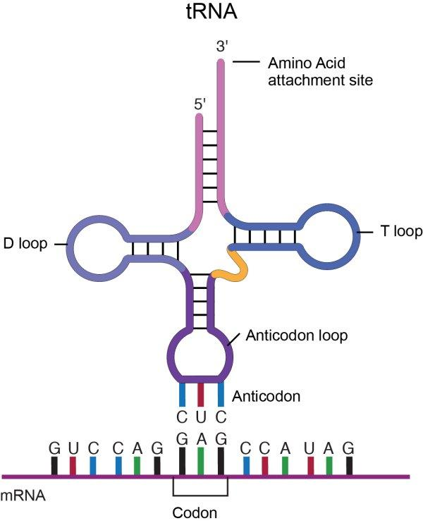
3 Types of RNA that you should know
mRNA
Messenger RNA: Transcribed in the nucleus, it carries the instructions to build proteins to the ribosomes in the cytoplasm.
rRNA:
Ribosomal RNA: Structure of the ribosomes important for synthesizing proteins
tRNA
Transfer RNA: Acts like an adaptor between the mRNA and the amino acids to build a protein.

Slide 8
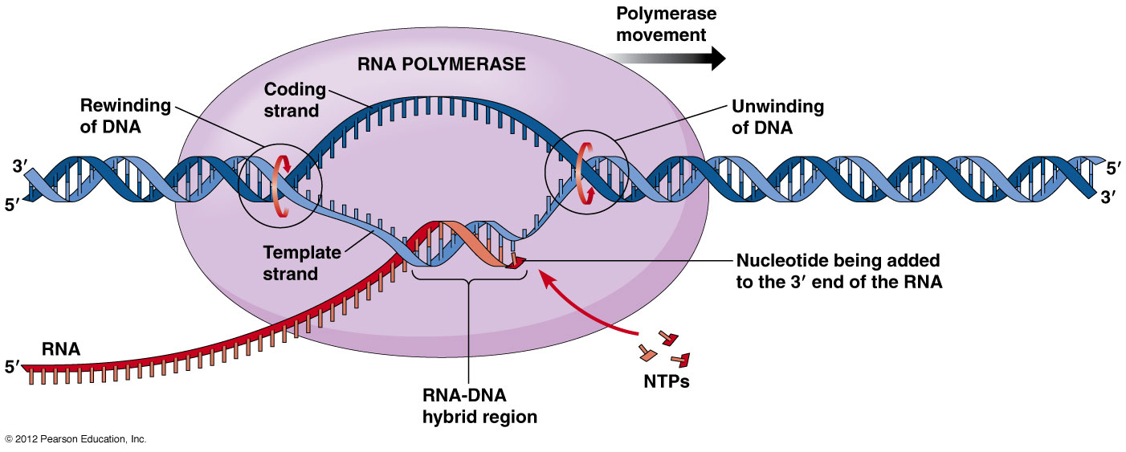
Transcription: Segment of DNA that codes for a protein is copied to mRNA
Step 1: Initiation
Step 2: Elongation
Step 3: Termination

Slide 9
Initiation
RNA polymerase binds to the promotor, unwinds DNA, and begins synthesizing a complimentary strand of RNA using DNA as a template
Promotor: Sequence of nucleotide bases that is recognized as starting point for a gene.
TATA Box

Slide 10
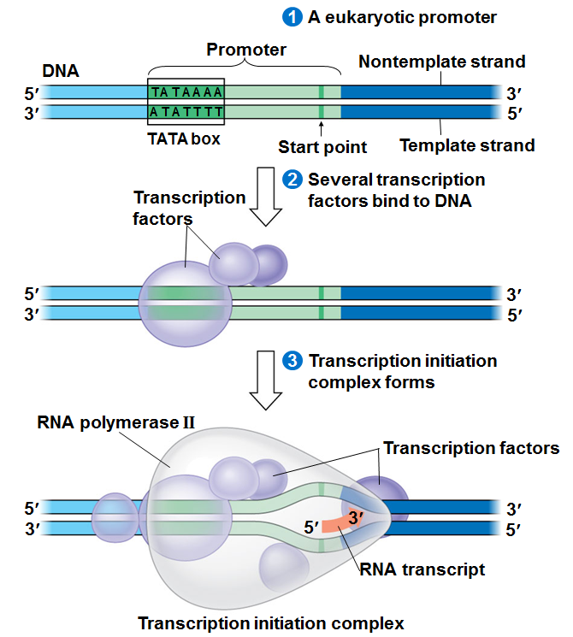
Initiation cont…..
1. RNA polymerase recognizes promoter region
Famous TATA Box
2. RNA polymerase binds to promoter
3. RNA polymerase untwist and unzips DNA and begins adding complimentary base pairs to DNA template
(Remember: A,U,C,G)

Slide 11
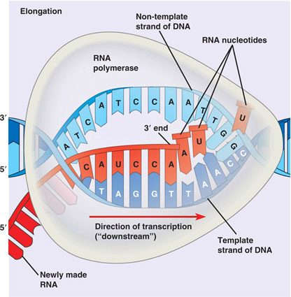
Elongation
RNA polymerase continues to unwind (and rewind behind it) DNA and synthesizes the mRNA by adding complementary base pairs.
Will continue until it reaches a sequence that tell it to stop.

Slide 12
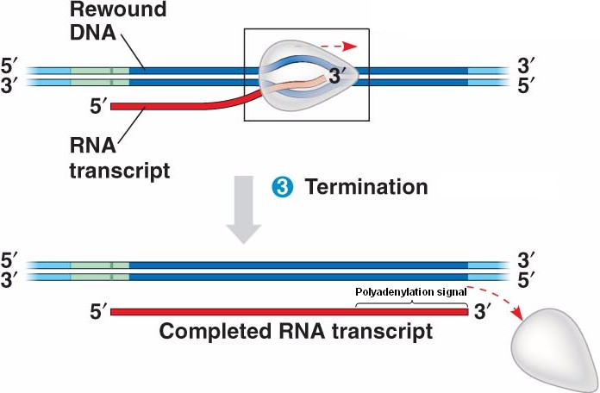
Termination
At the end of the gene there is a stop sequence (specific order of nucleotides) that makes RNA polymerase stop and fall off the DNA.

Slide 13
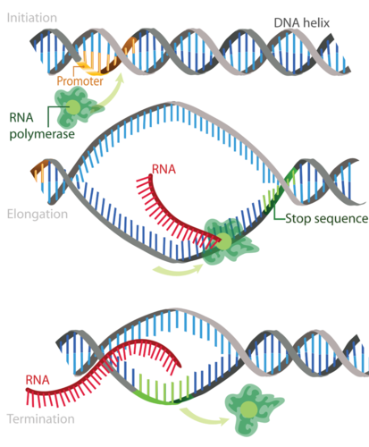
Transcription Overall
Initiation
Binding to promotor on DNA by RNA polymerase
Elongation
RNA polymerase adds bases to make the mRNA from the DNA template
Termination
Stop sequence makes RNA fall off and mRNA travels outside nucleus

Slide 14
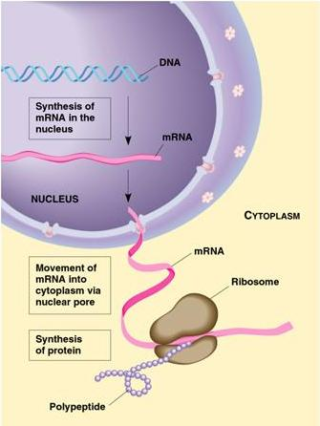
Woo-Hoo! We have mRNA! Now what????
After Termination, mRNA leaves the nucleus and goes to the cytoplasm to a ribosome for the next step of the central dogma…..
Translation!

Slide 15
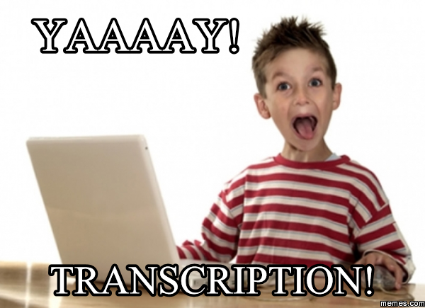
Elongation Base Pairing Example
Let’s transcribe the following DNA Sequence in mRNA
TAC CGG ATC CTA GGA TCA
AUG GCC UAG GAU CCU AGU
Now you try it with your neighbor
AGA CCT GCT GCT GGA TCA
UCU GGA CGA CGA CCU AGU

Slide 16
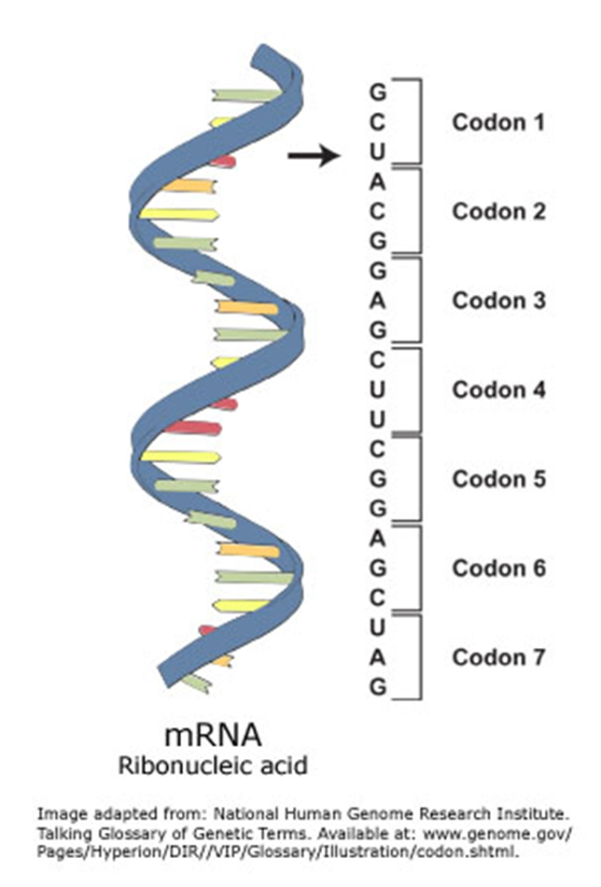
Genetic Code
How do 4 nitrogen bases code for 20 amino acids?
Codon: Sequence of 3 nucleotide bases (read as a triplet) that code for amino acids that build proteins.
1 codon= 1 amino acid
1 protein= many amino acids joined together
Called the Genetic Code: The use of codon triplets to determine protein synthesis.
Universal to ALL ORGANISMS!

Slide 18
From Codon to Amino Acid
GGU
CAU
GAC
UCA
Glycine
Histidine
Aspartic Acid
Serine

Slide 19
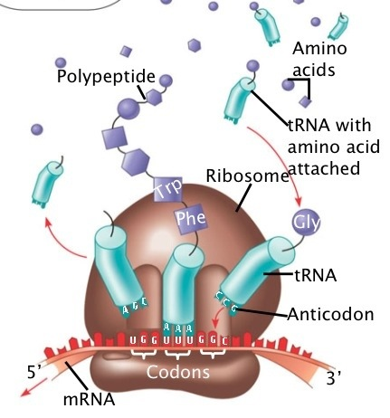
TRANSLATION: mRNA codons are decoded to create specific amino acid chain for a protein
Instructions from mRNA codons are used to build a protein
Occurs on ribosome (in the cytoplasm)

Slide 20
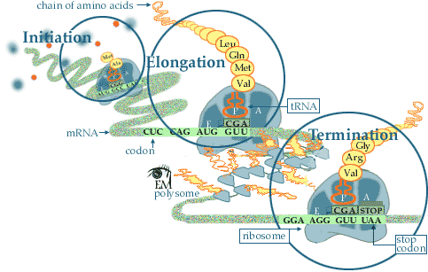
PROCESS OF TRANSLATION: 3 Steps
Initiation
Elongation
Termination

Slide 21
Transfer RNA
tRNA matches the codon (triplet base pair) with the correct amino acid
Each tRNA molecule only carries 1 amino acid
The anticodon (three nitrogen bases on tRNA) must complement the 3 bse codon for amino acid to be added to protein chain

Slide 22
Initiation
mRNA binds to ribosome
tRNA Start Codon attaches to mRNA sequence AUG
Start Codon= AUG
AUG codes for Methionine (abbreviated Met)

Slide 23
Elongation
Ribosome reads next codon (triplet base pairing) and tRNA brings correct amino acid based on genetic code
Order of nucleotides in mRNA determines order of amino acids in a protein
Amino acids are added by tRNA according to their codon sequence
Amino acids connected by peptide bonds

Slide 24
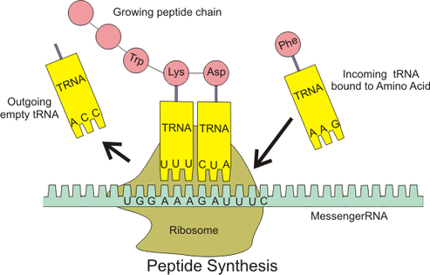
Elongation

Slide 25
Termination
Ribosome reaches STOP codon and polypeptide chain (the chain of amino acids) is released from ribosome
The amino acid chain then “folds” into a protein!

Slide 26
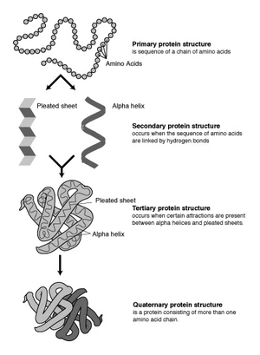
RESULT OF TRANSLATION: A Protein!
Much of how a Protein functions (what it does) is determined by how it is “folded”, meaning what shape it ends up.

Slide 27
One and done? No way!
More than one ribosome can translate an mRNA at one time, making it possible to produce many polypeptides (making many proteins) simultaneously from a single mRNA.

Slide 28
Central Dogma
Transcription
mRNA travels to cytoplasm via nuclear pore
Translation
Protein folds to final structure

